Slide 1
Chapter 13
Computer Organization and Architecture: Themes and Variations, 1st Edition Clements
Computer Organization and Architecture

Slide 2
Computer Organization and Architecture: Themes and Variations, 1st Edition Clements
Processor-level Parallelism
Up to now we have discussed parallelism in computing at the level of the pipeline or the superscalar processor.
In this final section we provide a brief overview of parallelism at the level of the multiple processor (multicore processor).

Slide 3
Computer Organization and Architecture: Themes and Variations, 1st Edition Clements
Review of Parallelism
Parallelism can be found in many aspects of the computer. Consider the following.
Pseudo-parallel Multitasking systems execute programs in parallel. Windows lets you surf the Internet while playing music from an mp3 file and copying data from one hard disk to another. This is pseudo-parallel because it is not parallel processing in a literal sense. Tasks are switched so rapidly that they appear to the human observer to be continuous.
Pipelining In pipelined systems, several instructions are in the process of being executed at the same time. The execution of individual instructions is overlapped. Because there is one execution unit, only one instruction can be completed in a clock cycle. By overlapping the execution of instructions, better use is made of all the processor’s hardware, allowing a significant performance enhancement.
You could say that pipelining offers the smallest granularity of parallelism where the overlap is in the individual sub-components of an instruction (fetch, decode, execute, etc.).

Slide 4
Computer Organization and Architecture: Themes and Variations, 1st Edition Clements
Superscalar In a superscalar processor, true parallel processing becomes possible because there are multiple execution units and several instructions can be executed in the same clock cycle.
The parallelism of superscalar processing is invisible to the user because it takes place within the CPU itself. Superscalar processing is visible only as an improvement in the performance of a processor over non-superscalar versions. Note that compiler technology can be used to ensure that the processor can find more instructions to execute in parallel.
Hyperthreading Hyperthreading is like multitasking: it offers a form of pseudo-parallelism. In a hyperthreaded computer there is one execution unit but other architectural resources are replicated, such as registers and the program counter. At any instant, one set of registers is in use.
When the current thread of execution stalls because a resource is unavailable (e.g., a load from main store is taking place and the data will not be available for another 100 clock cycles), another register set and program counter can be switched in and execution continues along a new thread (using the single execution unit). Hyperthreading hides the latency of memory loads.

Slide 5
Computer Organization and Architecture: Themes and Variations, 1st Edition Clements
Parallel processing True parallel processing uses multiple execution units in parallel to improve performance. The structures of parallel processing are legion and go beyond the scope of this text.
Parallel processing is used to create supercomputers by operating hundreds or thousands of CPUs in parallel.
Multicore CPUs Multicore processors are single chips that incorporate multiple CPUs. Advances in manufacturing technologies have allowed multiple processors to be fabricated on a single chip together with their interconnection networks, memory interface, and individual caches.
Multicore processors have been created because they offer a more cost-effective means of increasing computational throughput than by increasing the complexity and clock rates of single processors.

Slide 6
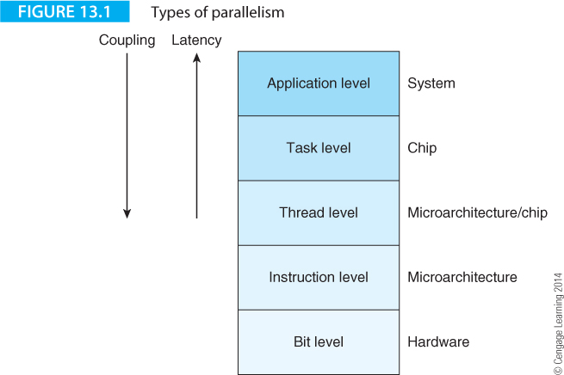
Computer Organization and Architecture: Themes and Variations, 1st Edition Clements
Figure 13.1 illustrates where parallelism can be implemented in a computer.
The bottom layer, the bit level, indicates parallelism in the hardware; for example, the ALU may perform floating-point operations by using parallel circuits. This level is entirely invisible to the user or operating system.
Above the bit level is the microarchitecture level that includes instruction level parallelism and superscalar techniques. Again, this level is invisible to the programmer.

Slide 7
Computer Organization and Architecture: Themes and Variations, 1st Edition Clements
The next level up is the thread level where tasks are decomposed into streams of instructions. This is the level supported by hyperthreading and is visible to the user/operating system because threads have to be allocated.
Above the thread level is the task level. Here, work can be partitioned and executed on the individual processors of a multiprocessor system.
At the top we have the application level, where entire jobs are run on the computers of a multiprocessor system. The difference between the application level and the task level is the granularity of the code executed on the individual processors.

Slide 8
Computer Organization and Architecture: Themes and Variations, 1st Edition Clements
Why Parallel Processing?
No sane person would ever use a parallel processor if they could avoid it. You have to replicate processors and provide a high-speed interconnection network to link processors.
The number of ways in which you can link processors, their topology, is vast and the optimum topology for one class of problem is not the same as for another (unlike single a processors whose topology that fits all problems).
You have to decide how to partition programs so that some code can run on all the processors at the same time, otherwise you will have a situation in which some or all of the parallel processors are doing nothing but consuming electrical power.

Slide 9
Computer Organization and Architecture: Themes and Variations, 1st Edition Clements
And the memory in a multiprocessor … it’s a nightmare.
Each processor has its individual or local cache memory.
Suppose processor A creates data P and writes it to its own cache A. If processor B wants to use data P and reads it from memory, it may get the old or stale P from its own cache B.
Somehow, we have to ensure that data remains consistent or coherent across all processors so that when A updates P in its cache, all other cached copies of P are either marked as invalid or updated.

Slide 10
Computer Organization and Architecture: Themes and Variations, 1st Edition Clements
We use parallel processing because it’s more cost-effective to use two or more processors in parallel rather than design a new processor that is twice as fast.
A few years ago processors were operating at just below 4 GHz and were dissipating a large amount of power.
Some PCs were using water cooling systems to keep the chip from melting.
Since power goes up with the square of clock frequency (all other factors being equal), it is unlikely that we will see commodity 8 GHz processors in the very near future.
Equally, no one would argue that slight modifications to a processor’s instruction set or to its microarchitecture will double its performance.
Chip manufacturers have been forced to follow Moore’s law in the only feasible way – put more processors on a die. Single-core processors gave way to dual core processors and then quad core processors in the late 2000s.

Slide 11
Computer Organization and Architecture: Themes and Variations, 1st Edition Clements
Power – the Final Frontier
The main reason that the microprocessor industry has adopted multicore processors so enthusiastically is the need to keep power consumption within limits
The power dissipated by a digital circuit can be expressed as
P_{total} = P_{switching} + P_{resistive} + P_{leakage}
= V_{dd}².F.C.k + V_{dd}.I_{resistive} + V_{dd}.L_{leakage}
The term in blue in the equation is related to the clock rate and one of the reasons for adopting multicore technology is to increase performance without increasing clock frequency.
Conversely, multicore processors have more computing power per Watt than single core processors.

Slide 12
Computer Organization and Architecture: Themes and Variations, 1st Edition Clements
Why is Parallel Processing so difficult to get right?
Making fast hardware is not particularly difficult. Getting high performance out of parallel hardware is. If you accelerate the performance of serial hardware, the system runs faster unless you run into bottlenecks with, for example, buses or memory. If you build parallel hardware, you get absolutely no increase in performance unless you can partition a task between individual processors. The way in which tasks are partitioned depends on the nature of the task, the way in which messages are passed between processors, and the synchronization of the tasks.
Not all real world problems are suitable to execution on parallel processors. One class of programs is called embarrassingly parallel because the subtasks can be easily assigned to individual processors. Moreover, the subtasks require little or no communication with other subtasks. Such embarrassingly parallel computations are common in image processing, cryptography, and weather prediction.
Some problems are difficult to parallelize; for example, iterative methods where the next calculation depends on the result of the previous calculation.

Slide 13
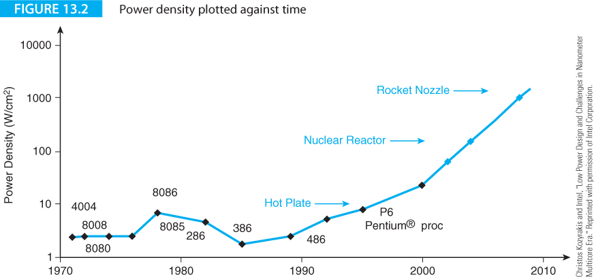
Computer Organization and Architecture: Themes and Variations, 1st Edition Clements
Figure 13.2 from Intel plots the power density of processors over the years.
The power dissipated is increasing exponentially. This situation cannot continue because we cannot remove heat from chips fast enough.
Already, some high-performance PCs have water-cooling systems to keep their processors from burning out.

Slide 14
Computer Organization and Architecture: Themes and Variations, 1st Edition Clements
Just another Brick in the Wall
Modern computing is all about overcoming limitations or walls. We have covered the memory wall, a barrier to progress caused by the increasing disparity between main store and CPU speeds.
The trend to multicore processors has been driven by the frequency wall and the heat wall. The frequency wall describes the limitation on clock speeds due to the quadratic relationship between clock frequency and power consumption. The heat wall describes the limitation due to increasing heat dissipation due to the ever increasing number of transistors on a chip.
There’s the Amdahl wall that is imposed by the limitation on the extent to which parallelism can be applied to any given problem.
There’s the atomic wall that manifests itself in three ways: fabrication (there is a limit to how small we can build things), quantum mechanics (as devices get smaller, quantum mechanical effects begin to predominate), statistical (as devices get smaller current flows become more governed by the laws of statistics than by conventional current models).
There’s the c wall, the speed of light. As clock speeds become faster, the time for signals to propagate through circuits becomes a limiting factor.
There’s a bank wall. Transistors have been getting cheaper over the years. The number of transistors per chip has increased exponentially according to Moore’s Law and the cost of building a fabrication plant has also risen dramatically. A fabrication facility in Taiwan constructed in 2012 cost $9.3 billion. The increasing cost of fabrication plants could lead to a reduced number of manufacturers, periodic chip shortages, and vulnerability to natural disasters.

Slide 15
Computer Organization and Architecture: Themes and Variations, 1st Edition Clements
Performance Revisited
Paradoxically, Amdahl’s law has been the driving power behind the move to multiprocessor systems but it has also poured cold water on the idea that multiprocessing can provide the performance increase that we have seen over the last 40 years.
Amdahl’s law is simple. If the fraction of a task that is executed serially is f_{s} then the fraction that can be executed in parallel is (1- f_{s}).
If n processors can be applied to the parallel code, the time is f_{s} + (1 – f_{s})/n.
The formula tells us that increasing n, the number of processors, reduces only the part that can be parallelized.
In the limit we are left with f_{s} that isn’t reducible. If f_{s} is 50%, using an infinite number of processors will only halve the execution time; not a great return on investment.

Slide 16
Computer Organization and Architecture: Themes and Variations, 1st Edition Clements
Consider the following.
Complicated computational problems can be tackled in many different ways; no two programmers would necessarily come up with the same way of solving a problem.
Amdahl’s equation assumes that the parallel part of the problem demonstrates perfect speedup (i.e., it neglects the cost of parallelization in terms of overheads and intertask communication).
Amdahl’s law assumes that infinite parallelization is possible. In practice, the parallel portion of a problem may saturate and reach the stage at which further parallelization is not possible.
It is assumed that the serial and parallel code is executed at the same rate. This may not necessarily be so. It may be possible to accelerate the serial part of a problem by the use of optimized hardware.

Slide 17
Computer Organization and Architecture: Themes and Variations, 1st Edition Clements
It is assumed that the serial portion of a program and the parallel portion cannot be overlapped.
Consider a simple example. A task has a serial part that takes 10s and a parallelizable part that consists of 20 operations each taking 5s.
Assume that 4s of the parallel processes can overlap the serial process.
What is the speedup if we use 20 processors?
The non-speedup time is 10s + 20 x 5 = 110s.
The basic Amdahl equation gives us 10s (the serial part) + 20 x 5s/20 = 15s
However, as we can overlap 4s of the parallel processing with the serial processing, we get 10s + 5s – 4s = 11s.

Slide 18
Computer Organization and Architecture: Themes and Variations, 1st Edition Clements
Some believe that Gustafson’s law has replaced Amdahl’s law. Gustafson argued that Amdahl’s law does not take account of scaling. Consider a problem whose execution time can be expressed as
f_{s} + (1 – f_{s})/n.
Suppose we scale the problem up and the new time is f ’_{s} + (1 – f ’_{s})/n, where f ’_{s} is the fraction of time the new problem spends executing serial code.
The essence of Gustafson’s argument is that f ’_{s} < f_{s} ; that is, scaling up reduces the fraction of serial time and makes it possible to use more processors to reduce the total time.
This is an appealing argument. For example, if you were simulating the flow of liquid in a pipe and scaled up the problem, the volume of liquid would increase as the square of the radius, but the surface area of the pipe would increase linearly with the radius of the pipe.
Since the more complex calculations occur at the pipe-liquid boundary, the fraction of complex calculations would decrease with the size of the problem. The same is true if we increase the number of sampling point

Slide 19
Computer Organization and Architecture: Themes and Variations, 1st Edition Clements
Flynn’s Taxonomy and Multiprocessor Topologies
The notion of using two or more computers in parallel to improve throughput has existed for over four decades. When computers were expensive mainframes, only large organizations could employ parallel processing – typically for scientific processing (weather simulation) or engineering (aerospace, military).
The introduction of relatively low-cost microprocessors made the design and construction of parallel processors more feasible and generated new interest in parallel processing.
Parallel processing includes two concepts: the topology or interconnection of the multiple processors and the distribution of tasks between individual processors. In 1972 M. Flynn wrote a classic paper that was to provide a standard taxonomy for the description of parallel systems (Some Computer Organizations and their Effectiveness).
Flynn’s classification is based on instruction execution and data flow and provides only a basic division between four generic computing structures. It does not cover the topology of multiprocessors.

Slide 20
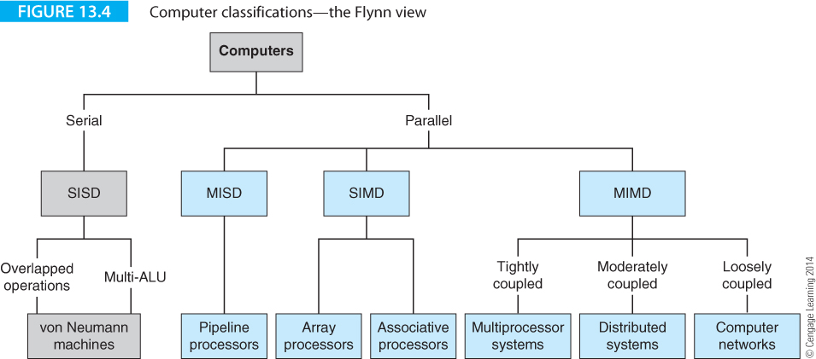
Computer Organization and Architecture: Themes and Variations, 1st Edition Clements

Slide 21
Computer Organization and Architecture: Themes and Variations, 1st Edition Clements
Flynn’s Classification
SISD The single instruction single data processor describes the conventional uniprocessor that executes instructions sequentially. Today’s highly pipelined superscalar processors are SISD machines only at the abstract level because of the inherent parallelism in their structure.
SIMD The single instruction multiple data processor describes a system whose instructions act on multiple data elements in parallel. Such machines were called array processors.
Modern microprocessors can be regarded as SIMD machines when they implement multimedia or short-vector operations because they are performing a single operation on multiple streams of data (the multiple streams being the individual sub-components of a word in a register).
SIMD machines have a single processor that determines instruction flow (instruction fetch and branch control) and multiple arithmetic or processing units that carry out data operations.

Slide 22
Computer Organization and Architecture: Themes and Variations, 1st Edition Clements
MISD Multiple instruction single data stream processors represent the rather improbable combination of multiple instruction streams and single data streams, (do several processors argue about which gets to process the single data element?).
An example of a MISD processor might be a highly-secure fault-tolerant processor employing multiple processors to operate on a single stream of data and then comparing the outputs of each processor in order to ensure reliable operation (such a system is employed in fly-by-wire aircraft).
MIMD Multiple instruction multiple data stream processors define systems in which two or more independent or autonomous processors operate on different streams of data. Distributed system and multicore processors are classified as MIMD machines.

Slide 23
Computer Organization and Architecture: Themes and Variations, 1st Edition Clements
Multiprocessor Coupling
Several parameters describe multiprocessors – Flynn’s classification, topology, and coupling.
The term coupling describes the degree of interconnection between the individual processors. The two extremes are loosely connected processors and tightly connected processors.
Most loosely connected processors are those that are connected via, for example, the Internet.
Data is exchanged relatively slowly (relative to the processor’s clock speed) and the granularity of data is high (entire files).
In a tightly coupled multiprocessor, data bandwidth is high and latency low because the processors share the same memory.
Multicore chips are very tightly coupled multiprocessors.

Slide 24
Computer Organization and Architecture: Themes and Variations, 1st Edition Clements
Multiprocessor Topologies
Multiprocessors contain two or more processing elements.
Although multiprocessors can use thousands of processing elements, we are interested in more modest systems that use multiple processors to increase computational power without incurring the power dissipation penalties of high clock rates.
The two types of multiprocessor of interest to us are board-level multiprocessors and chip-level multiprocessors.
Board-level multiprocessors use several separate chips, typically up to four, on the motherboard.
Chip-level multiprocessors are now called multicore processors and employ several processors on the same chip.

Slide 25
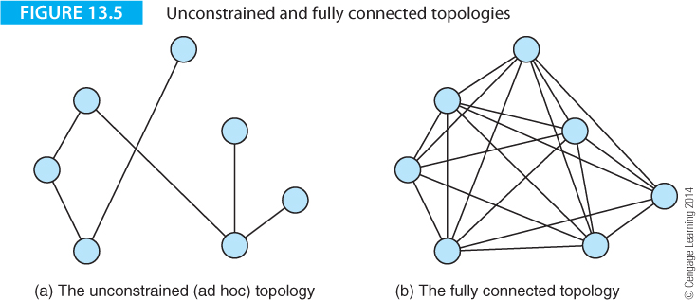
Computer Organization and Architecture: Themes and Variations, 1st Edition Clements
Figure 13.5 describes two topology extremes, the unconstrained or ad-hoc topology and the fully-connected topology.
In the former, processors are connected if they need to communicate with each other and unconnected otherwise. In a fully-connected topology, each processor has a direct connection to every other processor. Both these topologies are generally undesirable.

Slide 26
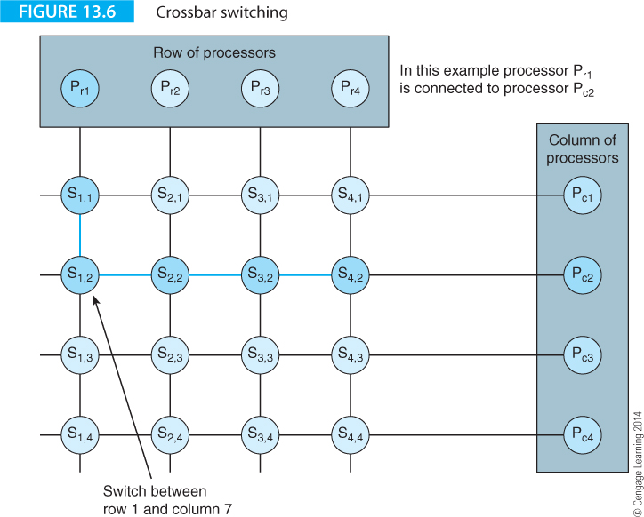
Computer Organization and Architecture: Themes and Variations, 1st Edition Clements
Figure 13.6 describes crossbar switching (the routing once used in manual telephone exchanges).
P_{ri} indicates the i^{th} processor in the row and P_{cj} indicates the j^{th} processor in the column.
The notation S_{p,q} indicates a switch between row p and column q.

Slide 27
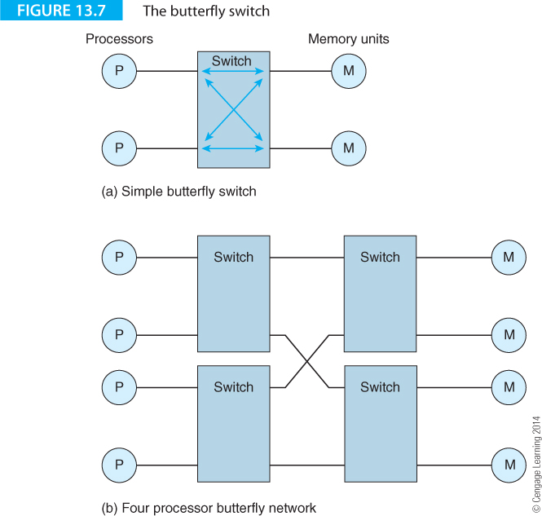
Computer Organization and Architecture: Themes and Variations, 1st Edition Clements
Figure 13.7 illustrates a butterfly switch and a network made up of four butterfly switches. A butterfly switch connects two horizontal pairs of processors left-to-right or switches processors top-left to bottom-right and vice versa.
Structures using butterfly switches can be iterated to create fast, effective and scalable switching mechanisms.

Slide 28
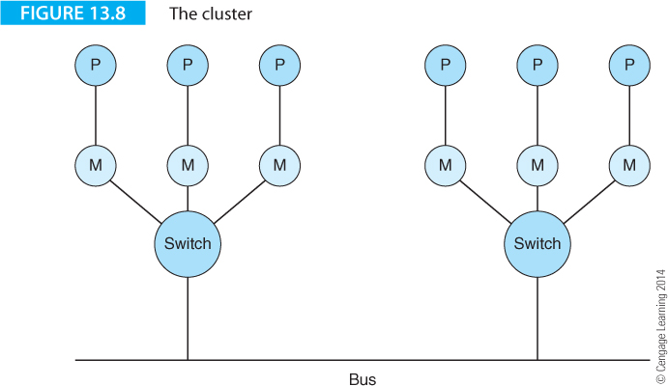
Computer Organization and Architecture: Themes and Variations, 1st Edition Clements
Figure 13.8 demonstrates the cluster, where groups of processors are linked by a switch to a common bus.
The cluster can be used to provide highly reliable computing by allowing the processors in a cluster to check each other’s operation.

Slide 29
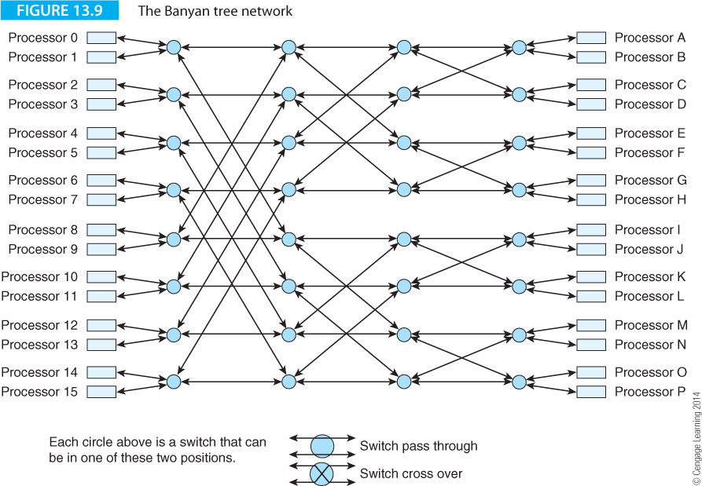
Computer Organization and Architecture: Themes and Variations, 1st Edition Clements
Figure 13.9 illustrates the Banyan tree constructed with arrays of butterfly switches.
Banyan networks support multicast operations in which one processor can be simultaneously connected to several other processors.

Slide 30
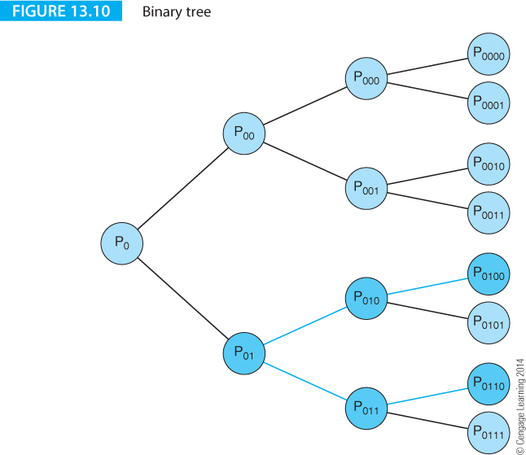
Computer Organization and Architecture: Themes and Variations, 1st Edition Clements
Figure 13.10 describes the binary tree architecture.
Processor P₀₁₀₀ is communicating with processor P₀₁₁₀ by routing the connection back two nodes and then forward two nodes.

Slide 31
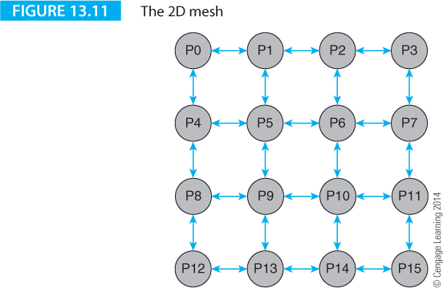
Computer Organization and Architecture: Themes and Variations, 1st Edition Clements
Figure 13.11 illustrates the two-dimensional mesh, where processing units are arranged on a regular grid.
This is an important topology because it is used by the networks on a chip (that fabricate arrays of processors on a single chip.

Slide 32
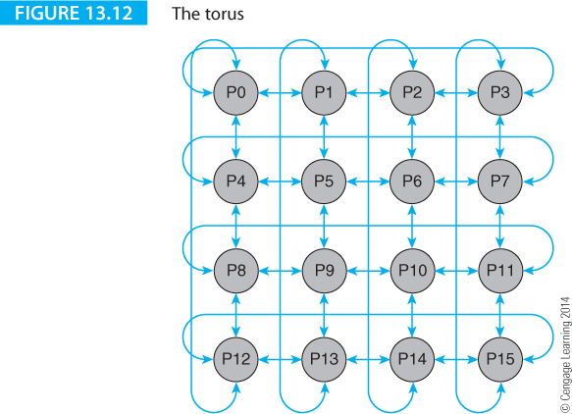
Computer Organization and Architecture: Themes and Variations, 1st Edition Clements
Figure 13.12 shows an extension of the 2D array called the torus, where processors along the edges are connected to processors at the opposite edge to improve connectivity.

Slide 33
Computer Organization and Architecture: Themes and Variations, 1st Edition Clements
These is a wealth of multiprocessor technologies, each with its own properties, such as cost, switching complexity, resistance to failure (some topologies rely on a single node, as in Figure 13.10, while others are robust and permit multiple paths between processors), and fitness for purpose.
The last factor is an indication of how well the software maps onto the hardware.
A multiprocessor architecture intended for matrix algebra might not be optimum for fast Fourier transforms (the basis of much signal processing).
We are going to concentrate on the relatively simple, tightly-coupled, SMT systems provided by multicore processors.
Before that we look at two topics, the structure of memory in multiprocessor systems and the problems posed by cache memory.

Slide 34
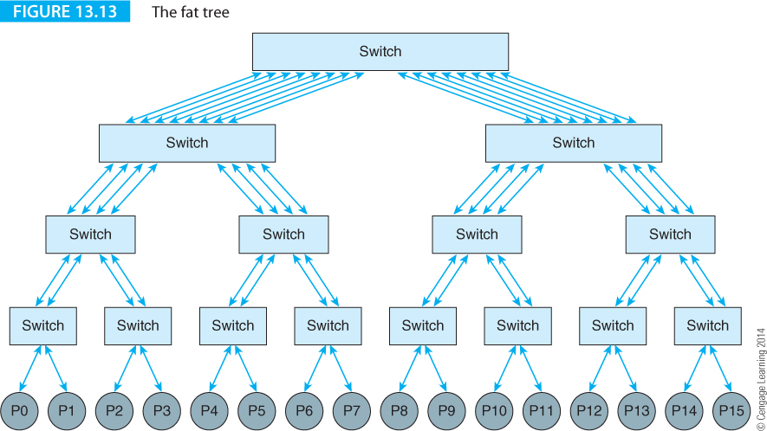
Computer Organization and Architecture: Themes and Variations, 1st Edition Clements
Figure 13.13 illustrates the fat tree topology that employs multiple buses. The use of a fat tree avoids blocking when pairs of processor communicate with each other and block communication paths.
By doubling the number of communications paths at each switching unit, it becomes possible to allow any processor to communicate with any other processor. The fat tree supports all-to-all multicasting in which any processor can broadcast to all other processors simultaneously

Slide 35
Computer Organization and Architecture: Themes and Variations, 1st Edition Clements
Memory in Multiprocessor Systems
A computer has a memory hierarchy including cache and main store.
A multiprocessor system begs the question, ‘Who gets what memory and where?’
The simplest possible memory arrangement would be to have a single global memory unit that could be accessed by all processors.
Such a simple scheme is unworkable because only one processor at a time can access memory, leaving all other processors with nothing to do.
Each processor must be able to access memory (have its own cache).

Slide 36
Computer Organization and Architecture: Themes and Variations, 1st Edition Clements
Parallel processors are divided into two groups according to the way in which memory is accessed.
One group is UMA (uniform memory access) and the other is NUMA (non-uniform memory access).
Systems with UMA structures treat memory symmetrically and all processors have equal access to memory, whereas systems with NUMA memory treat memory non-symmetrically.
In a NUMA system the access time of some memory may be much longer than other memory.
NUMA systems typically involve distributed clusters of processors connected by buses or local area networks.

Slide 37
Computer Organization and Architecture: Themes and Variations, 1st Edition Clements
NUMA Architectures
NUMA-based networks may or may not use cache memory that is accessible by multiple processors. In a weakly-coupled cluster of processors, an individual processor may have its own memory and its local cache.
This local memory and cache may not be directly accessible by other processors, because information is transferred between processors via messages, rather than as actual memory accesses.
Some NUMA-based systems are called CC-NUMA (cache-coherent NUMA), where processors maintain their own cache memories that are accessible by other processors.
CC-NUMAs have relatively low latencies and high bandwidths at the expense of complicated methods of ensuring cache coherency.
If a processor updates its own local cache, the corresponding data in other caches must either be updated too or declared invalid.

Slide 38
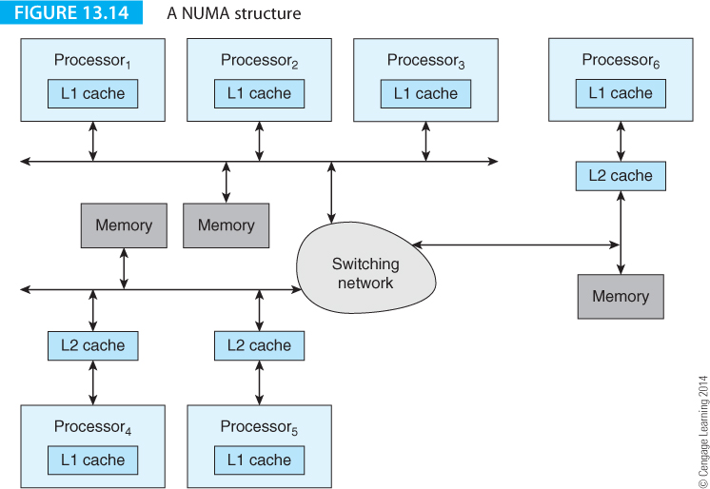
Computer Organization and Architecture: Themes and Variations, 1st Edition Clements
Figure 13.14 illustrates a generic CC-NUMA structure consisting of three clusters of computers interlinked by a network. Note that some processors have L2 caches and some do not.
NUMA systems are characterized by their ad-hoc approach to networking; for example, it takes longer for Processor₁ to access Processor₆’s memory than to access Processor₂’s memory.

Slide 39
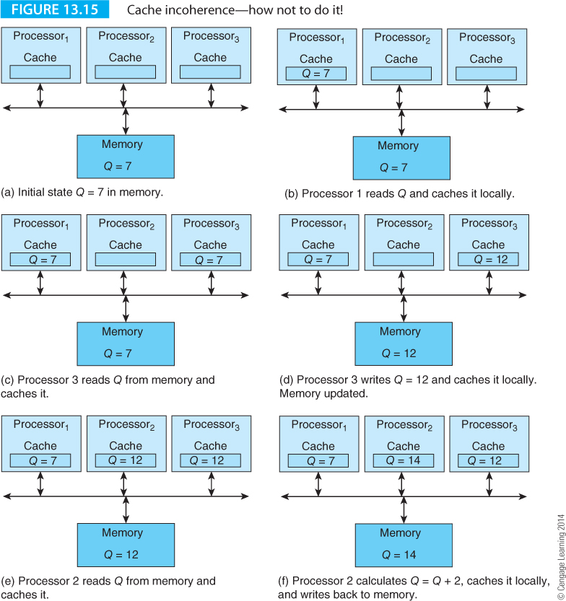
Computer Organization and Architecture: Themes and Variations, 1st Edition Clements
Cache Coherency in Multiprocessor Systems
Figure 13.15 illustrates the cache coherency problem.

Slide 40
Computer Organization and Architecture: Themes and Variations, 1st Edition Clements
There are five states in the figure. Initially, in state (a) there is a variable Q in memory with the value 7.
In state (b) Processor 1 reads Q and caches it locally.
In state (c) Processor 3 also reads Q and caches it. In stage (d) Processor 3 writes 12 to Q in its local cache and to memory.
In state (e) Processor 2 reads Q and caches it.
Finally, in state (f) Processor 2 reads Q and increments it by 2, caches it and updates main memory.
At this point we have three different cached values of Q because each processor’s cache has not taken account of the activity of the other processors.

Slide 41
Computer Organization and Architecture: Themes and Variations, 1st Edition Clements
The MESI Protocol
There are many ways of dealing with cache coherency and several mechanisms have been proposed.
One protocol has become very common in today’s multiprocessor systems, the so-called MESI protocol that was introduced into Intel’s Pentium processors.
The MESI protocol is found in UMA (or SMT) multiprocessor systems that are bus-based because it relies on a mechanism called snooping.
When a processor performs a write, the write is broadcast on the bus and all cache memories observe the write.
A consequence of snooping is that coherency mechanisms that rely on it are not scalable beyond about 128 processors because of the extra bus traffic that snooping generates.

Slide 42
Computer Organization and Architecture: Themes and Variations, 1st Edition Clements
MESI is just one of a bunch of cache coherency protocols. These protocols take their acronyms from the states in which a cache memory can exist. MSI is the basic protocol, MESI is the protocol used by Intel and MOESI is used by AMD (Intel began to use the MESIF protocol, an extended version of MESI, with the Nehalem architecture).
MSI stands for modified, shared, invalid and refers to the three possible states that a line in a cache may take; that is, each cache line is required to store its current state. A cache line in the I (invalid) state does not contain valid data (i.e., the only valid data is in the memory).
A cache line that is in the M (modified) state represents a single valid copy of the data; all other copies must be invalidated. Moreover, a line in the M state is dirty and must eventually be written back to memory.
A cache line in the S (shared) state indicates that unmodified copies of the line exist in other caches.
The M state indicates that the line is currently owned by the cache’s local processor and the copy in memory is stale, whereas the S state indicates that the line is an up-to-date version of the copy in memory.

Slide 43
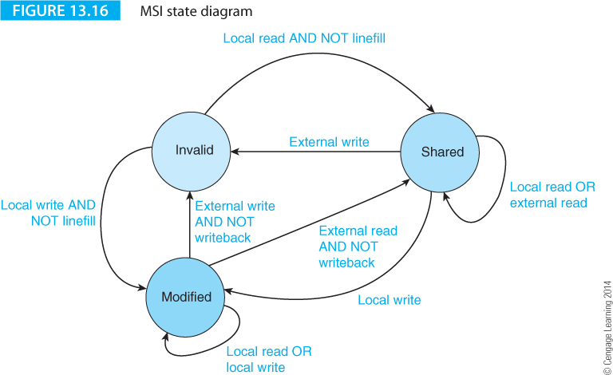
Computer Organization and Architecture: Themes and Variations, 1st Edition Clements
Figure 13.16 gives a state diagram for the MSI protocol. There is a state machine for each line in each cache in the system. Transitions between states take place as a result of a read or write by a local processor, or as the result of a bus snooping operation.
For example, if a line is in a shared, S, state and its local processor writes to it, it enters the M (modified) state. All other copies of this line now must be invalidated.

Slide 44
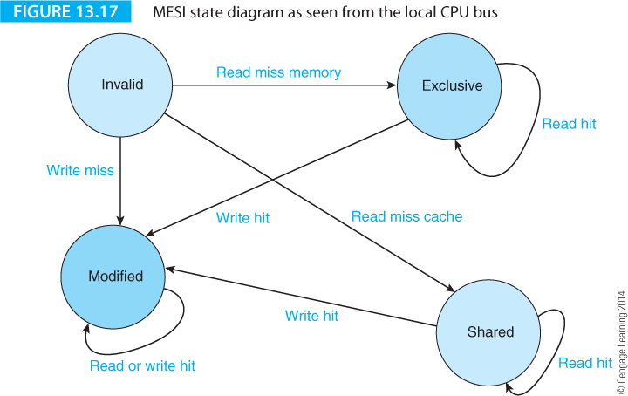
Computer Organization and Architecture: Themes and Variations, 1st Edition Clements
Figure 13.17 gives the state diagram for the MESI protocol as seen from the local CPU bus; that is, these are the state transitions caused by the local processor.

Slide 45
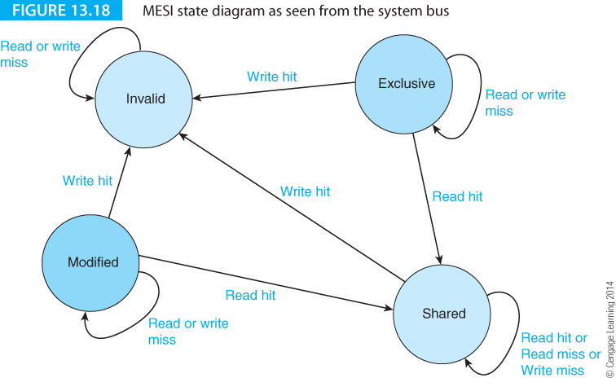
Computer Organization and Architecture: Themes and Variations, 1st Edition Clements
Figure 13.18 gives the state diagram for the same cache line caused by other processors and snooping activity on the bus

Slide 46
Computer Organization and Architecture: Themes and Variations, 1st Edition Clements
Multithreading
Two bottlenecks in computing are the branch penalty and load latency.
We’ve already seen that you can reduce the branch penalty by predicting the outcome of a branch and fetching instructions from the target address, or by using predicated execution.
Load latency is harder to deal with because you can’t avoid reading data.
If you are lucky and the data is in the cache, the load latency may be as little as one or two cycles.
If the data is not cached, the load latency may be tens of cycles if it’s in main store, and millions of cycles if it’s on disk. As time passes, the penalty imposed by load latencies is getting relatively worse as processors are getting faster at a greater rate than memory.

Slide 47
Computer Organization and Architecture: Themes and Variations, 1st Edition Clements
You can’t eliminate latency, but you can hide it. Instead of waiting for data, the processor can exploit the processor’s computing capacity by doing something else. This approach to latency hiding is called multithreading.
Multithreading hides the latency of cache misses and allows you to run several streams or threads at once.
Multitasking involves longer streams of instructions than multithreading and task switching occurs less frequently than with multithreading.
A task switch may take place on a page fault, whereas a thread switch may take place on a cache miss.
The overhead involved in switching is considerable because it is necessary to execute all pending instructions, save the registers and flush the cache.

Slide 48
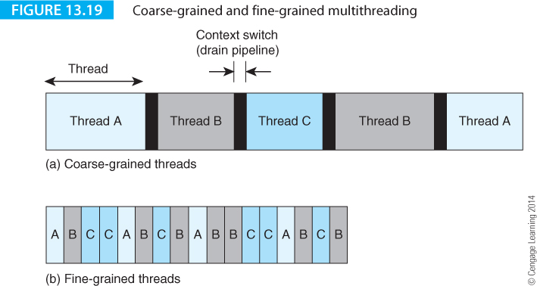
Computer Organization and Architecture: Themes and Variations, 1st Edition Clements
Thread switching is efficient because hardware keeps multiple copies of registers to eliminate the need to save/restore registers on context switches.
Multithreading can be coarse- or fine-grained.
In Figure 13.19(a), threads are switched after a group of instructions have been executed and the pipeline is drained each time a switch takes place.

Slide 49
Computer Organization and Architecture: Themes and Variations, 1st Edition Clements
Figure 13.19(b) demonstrates fine-grained multithreading where switching takes place at the end of each cycle.

Slide 50
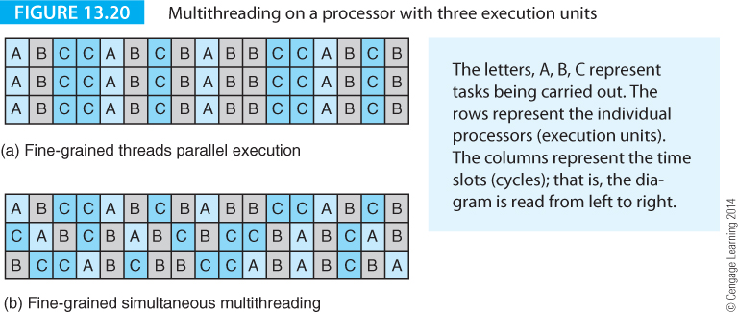
Computer Organization and Architecture: Themes and Variations, 1st Edition Clements
Thread level parallelism is applied to multiprocessor systems with two or more processors that allow several different threads to be executed in parallel. Such a scheme is inefficient if sufficient streams can’t be found to keep all the processors busy.
Multithreading can be applied to processors that incorporate instruction level parallelism

Slide 51
Computer Organization and Architecture: Themes and Variations, 1st Edition Clements
Consider the idealized situations of Figures 13.20(a) and 13.20(b). In Figure 13.20(a), multithreading is performed with each thread occupying all three execution stages in the same clock cycle.
Figure 13.20(b) represents fine-grained simultaneous multithreading, in which each execution unit is available to any thread. At any instant, instructions from three different may be executing on three execution units.

Slide 52
Computer Organization and Architecture: Themes and Variations, 1st Edition Clements
Consider the idealized situations of Figures 13.20(a) and 13.20(b). In Figure 13.20(a), multithreading is performed with each thread occupying all three execution stages in the same clock cycle.
Figure 13.20(b) represents fine-grained simultaneous multithreading, in which each execution unit is available to any thread. At any instant, instructions from three different may be executing on three execution units.

Slide 53
Computer Organization and Architecture: Themes and Variations, 1st Edition Clements
Consider the idealized situations of Figures 13.20(a) and 13.20(b). In Figure 13.20(a), multithreading is performed with each thread occupying all three execution stages in the same clock cycle.
Figure 13.20(b) represents fine-grained simultaneous multithreading, in which each execution unit is available to any thread. At any instant, instructions from three different may be executing on three execution units.

Slide 54
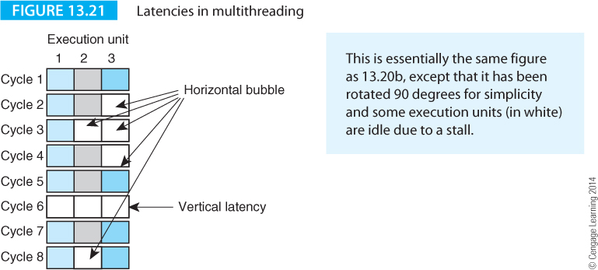
Computer Organization and Architecture: Themes and Variations, 1st Edition Clements
Figure 13.20 is misleading because it represents the situation in which execution units are always being utilized.
Real processors suffer from hazards and the situation in which all execution units cannot be used in the same cycle because insufficient instructions can be found to execute in parallel.
Figure 13.21 illustrates these limitations where a white square indicates that the corresponding unit is not executing an operation in that cycle; for example, in cycle 2 execution unit 3 is idle and in cycle 6 all units are idle.

Slide 55
Computer Organization and Architecture: Themes and Variations, 1st Edition Clements
A horizontal bubble occurs when all execution units cannot be utilized; for example a system with two integer units and a floating-point unit doesn’t use a slot when a floating-point instruction isn’t part of the instruction stream.
Clock cycle 6 is labeled vertical latency because an instruction in cycle 6 stalls all units for one clock.
The aim of fine-grained simultaneous multithreading is to keep as many units of the processor occupied for as much of the time as possible.

Slide 56
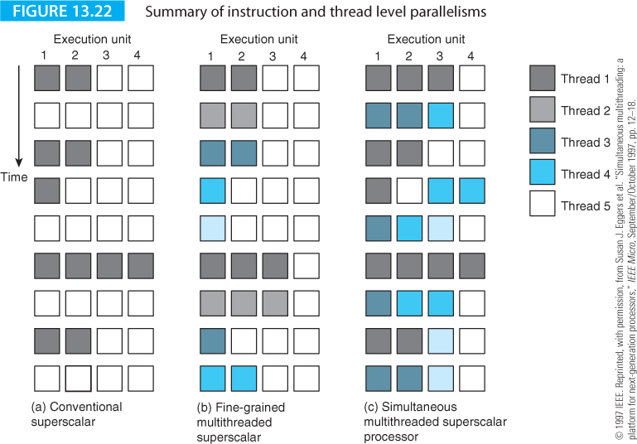
Computer Organization and Architecture: Themes and Variations, 1st Edition Clements
A necessary condition for efficient simultaneous multitasking, SMT, is the absence of any significant overhead associated with thread switching.
Each thread has a different processor context (PC, status and registers). It’s necessary for a thread to have its own resources. SMT requires the duplication of registers and the tagging of instructions with the thread number.

Slide 57
Computer Organization and Architecture: Themes and Variations, 1st Edition Clements
Figure 13.22 illustrates the differences between a superscalar processor, a fine-grained multithreaded processor and a simultaneous multithreaded processor. The superscalar processor is inefficient because of latencies and data dependencies. The fine-grained superscalar improves the situation by interleaving. The SMT processor is able to fill more of the execution units by finding instructions from any available thread.

Slide 58
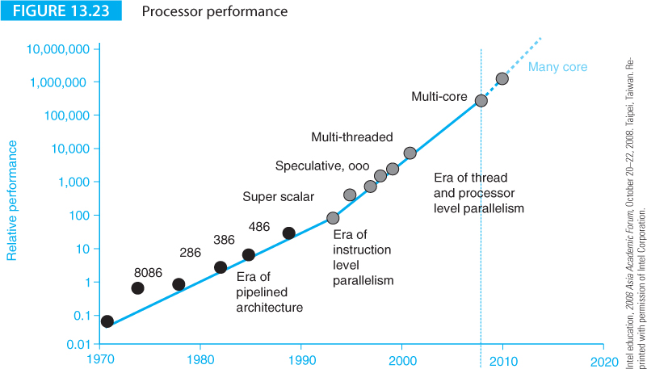
Computer Organization and Architecture: Themes and Variations, 1st Edition Clements
Multicore Processors
Over four decades the number of transistors on a chip has increased in accordance with Moore’s law. Clock frequencies have also increased dramatically over the same period.
Figure 13.23 provides a reminder of the improvement in performance of processors over the years and demonstrates how the era of instruction level parallelism is giving way to the domain of the multicore.

Slide 59
Computer Organization and Architecture: Themes and Variations, 1st Edition Clements
Homogenous and Heterogeneous Processors
Multicore processors can be divided into two categories, homogeneous or heterogeneous.
A homogeneous processor employs a set of identical cores where every core is an identical copy of all the other cores.
A heterogeneous multicore processor includes cores that differ in ISA, or chip area, or performance, or power dissipation.
Early multicore processors were generally homogeneous with one core being duplicated.
The benevolent Moore’s law has enabled sufficient numbers of active devices to be fabricated on a chip to develop systems where different types of core can be optimized for different functions.
This is particularly true of the advanced processors found in commodity applications such as games consoles.

Slide 60
Computer Organization and Architecture: Themes and Variations, 1st Edition Clements
Homogeneous Multiprocessors
The multicore CPU was yet another inevitable step.
From the early days of 16-bit microprocessors, the multiprocessor was beginning to appear in an asymmetric form via the coprocessor.
Coprocessors are asymmetric because they provide additional processing power but in a different form (floating-point, graphics, physics engines).
The Pentium was designed to support symmetric multiprocessing and incorporated hardware mechanisms to allow dual-processor motherboards.
The number of transistors in a chip increased from about three million in 1993 to two billion in 2011.
The next step was obvious: put two processors in the same physical housing.

Slide 61
Computer Organization and Architecture: Themes and Variations, 1st Edition Clements
IBM introduced a high-end dual-core processor that put two 64-bit POWER processors on its POWER4 chip in 2001.
Intel introduced its mass-marketed dual core processor in 2005 (a Pentium 840 Extreme Edition).
At almost exactly the same time, AMD brought out its Opteron 800 Series.
Intel’s first dual-core processor was really two processors in the same package that were not well integrated.
Intel rapidly brought out the Core 2 Duo to replace the Dual Core Pentium.
The Core 2 Duo was specifically designed for dual-processor systems.

Slide 62
Computer Organization and Architecture: Themes and Variations, 1st Edition Clements
What is a Core?
The term core in multicore computing is rather misleading because its meaning is not precisely defined.
At one extreme a core could be the same as a microprocessor and a multicore chip could have two or more identical processors on the same chip.
Such an arrangement would imply that the CPU, cache memory, memory management system and even the bus interface, were duplicated for each chip.
At the other extreme, a core could have just a processing unit, while a multicore chip could have a CPU plus several processing units (without associated program control and sequencing).
Finally, a multicore chip could have several CPUs that share certain common facilities, such as memory and the external interface.

Slide 63
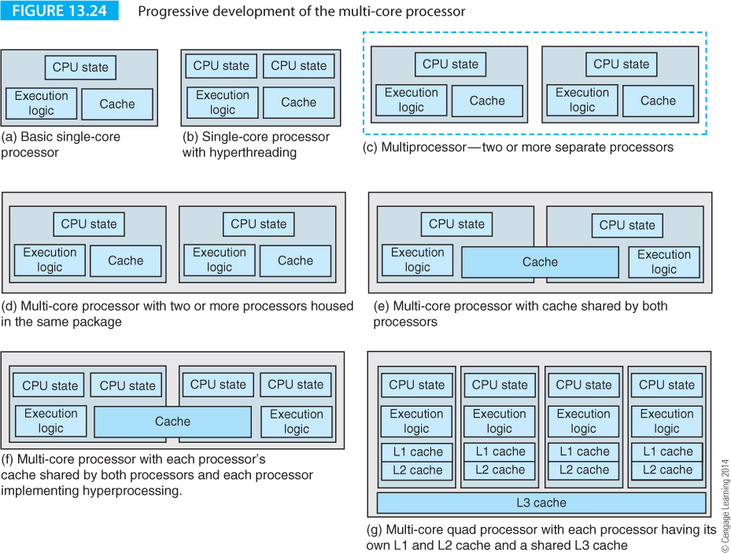
Computer Organization and Architecture: Themes and Variations, 1st Edition Clements
Figure 13.24 summarizes the growth of the multiprocessor chip and its relationship to cache
Figure 13.24(a) describes the three blocks of a processor. The CPU state incorporates the registers (and PC/status register) that define the current state of the processor and the thread it is executing.

Slide 64
Computer Organization and Architecture: Themes and Variations, 1st Edition Clements
In (b) we have added a second set of CPU state registers to allow two threads to be executed concurrently by switching between state registers whenever one thread is stalled by a data load.

Slide 65
Computer Organization and Architecture: Themes and Variations, 1st Edition Clements
Figure 13.24(c) describes a multiprocessor system where two processors share the same environment (motherboard). The dotted blue line indicates that they are in the same system but not on the same chip.

Slide 66
Computer Organization and Architecture: Themes and Variations, 1st Edition Clements
Figure 13.24(d) describes a multicore processor which is the same as (c) but the processors are now on the same chip.

Slide 67
Computer Organization and Architecture: Themes and Variations, 1st Edition Clements
Figure 13.24(e) is an extension of (d) in which the cache is shared between processors. This indicates an increasing degree of coupling between individual processors on the same chip.

Slide 68
Computer Organization and Architecture: Themes and Variations, 1st Edition Clements
In (f) we have added hyperthreading to (e) to allow each of the individual processors to execute multiple threads.

Slide 69
Computer Organization and Architecture: Themes and Variations, 1st Edition Clements
Figure 13.24(g) increases the number of cores to four and shows that we can choose how to distribute the individual cache levels. Each processor has a private level 1 and 2 cache but shares the much larger L3 cache.

Slide 70
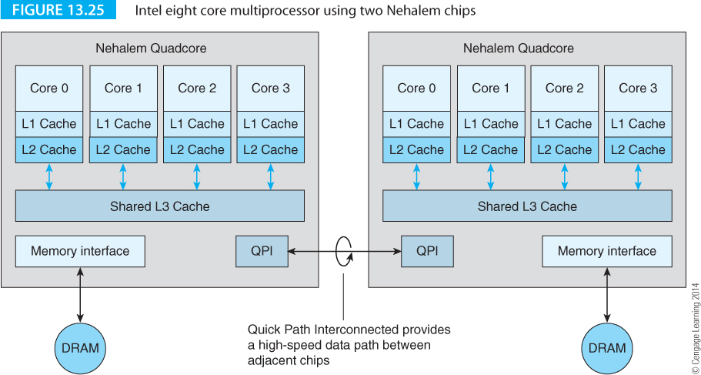
Computer Organization and Architecture: Themes and Variations, 1st Edition Clements
Intel Nehalem Multicore Processor
Intel’s Nehalem architecture was introduced in 2008 with the Core i7. Figure 13.25 describes a system using two Nehalem chips. Each chip has four cores and all four cores share a common L3 cache. A QPI, quick path interconnect, provides an external interface allowing clusters of chips to be connected together.

Slide 71
Computer Organization and Architecture: Themes and Variations, 1st Edition Clements
AMD Multicore Processors
AMD is Intel’s principal competitor and has long worked to maximize its share of the market. Part of that strategy has been a move from single core to multicore processors.
AMD’s multiprocessing strategy depends strongly on HyperTransport technology that uses high-speed serial data links to exchange information, in a similar way to PCIexpress but with a lower overhead. Figure 13.26 demonstrates a system using two Athlon 64 FX dual processors linked by HyperTransport buses.

Slide 72
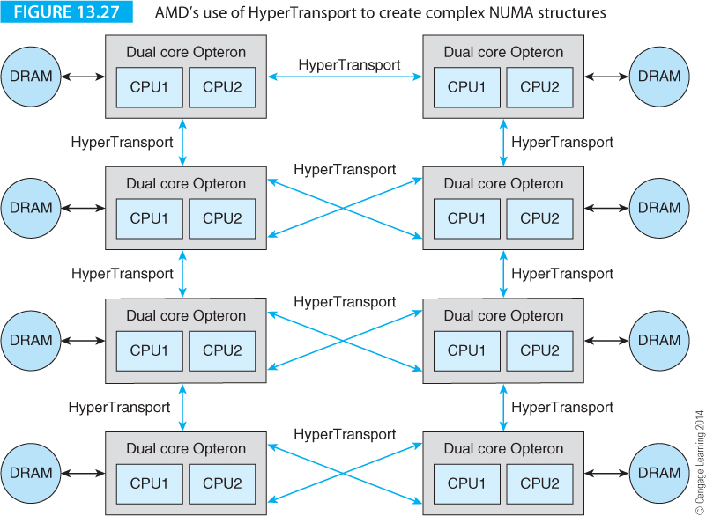
Computer Organization and Architecture: Themes and Variations, 1st Edition Clements
Figure 13.27 depicts a more sophisticated example, where eight dual-core processors can be combined with HyperTransport technology to create a NUMA multiprocessor network with crosslinked processors.

Slide 73
Computer Organization and Architecture: Themes and Variations, 1st Edition Clements
CPU Throttling
For a long time computers ran at the highest speed possible. That was axiomatic – no sane person would buy a processor and then deliberately run it at a slower speed than necessary. However, in an age where power is limited by batteries or the equipment is in danger of becoming too hot, reducing the clock rate from the maximum becomes essential.
CPU throttling or dynamic frequency scaling is a technique used to reduce power consumption by reducing the frequency of the clock. Throttling can be used to reduce the clock rate of processors that are idle, or to reduce CPU clock rates when long-latency memory accesses are taking place. Another power-saving technique is to power down areas of the processor not currently in use.
Intel calls its power reduction system SpeedStep technology and AMD uses the term Cool’n’Quiet in desktop environments and PowerNow! in mobile environments. As its name suggests, Cool’n’Quiet technology also works in conjunction with fan control in desktop processors to reduce fan speed and noise when the chip’s temperature falls.

Slide 74
Computer Organization and Architecture: Themes and Variations, 1st Edition Clements
ARM Cortex A9 Multicore
The Cortex A9 is a general-purpose processor intended for mobile applications and is available with 1, 2, 3, or 4 cores. A9 Cortex processors can be configured for specific applications. Some of the attributes of the A9 are:
Superscalar pipelined processor core
NEON media processing engine – ARM’s own SIMD instruction set with 32 64-bit-wide registers that can be used as 16 128-bit registers.
Floating-point unit
Thumb-2 technology – ARM’s compressed code mechanism
Jazelle technology – this is ARM’s on-chip support for Java and enables the direct execution of Java’s native bytecode. This allows ARM processors to have three states, each executing a different native instruction set architecture.

Slide 75
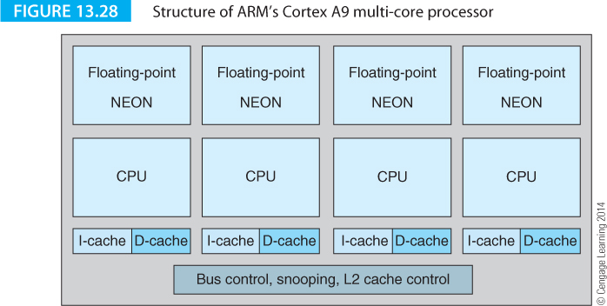
Computer Organization and Architecture: Themes and Variations, 1st Edition Clements
Figure 13.28 describes the structure of the Cortex A9.
ARM is an IP company and this processor can be configured in several different ways depending on the wishes of the user.
Other special-purpose coprocessors such as cryptographic accelerators can be incorporated. Bus snooping control is incorporated on chip but there is no L2 cache.

Slide 76
Computer Organization and Architecture: Themes and Variations, 1st Edition Clements
IBM Power7
IBM championed RISC architecture from the very beginning. Credit for RISC architectures is usually given to John Cock at IBM for his pioneering work on the 801 project (a RISC architecture that was never implemented) in 1974.
IBM’s first commercially successful RISC processor was the POWER architecture that later formed the basis for the PowerPC used by Apple. IBM’s first computers using this architecture appeared in 1990 (the RS/6000 series).
The POWER architecture itself continued to be developed for IBMs high-performance workstations, with POWER7 being introduced in 2010.

Slide 77
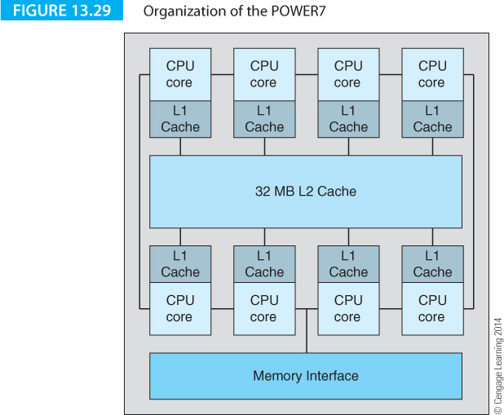
Computer Organization and Architecture: Themes and Variations, 1st Edition Clements
Figure 13.29 describes the POWER7 which has eight cores using 1.2 billion transistors. Individual cores can be turned off to save energy. Clock frequencies can also be modified to reallocate energy. The L2 caches are 256 KB and the shared L3 cache is 32 MB. The cores support out-of-order execution and provide two fixed point ALUs, two floating-point units and a decimal floating-point unit. A decimal FPU is rather unusual today.

Slide 78
Computer Organization and Architecture: Themes and Variations, 1st Edition Clements
The War is on all Fronts
Where is the battle to improve computer performance taking place? That answer is that it’s on all fronts and the POWER7 demonstrates the truth of this. POWER7 is a development of previous versions of this architecture and, like its contemporaries; it takes an aggressive approach to multiprocessing.
However, the inclusion of a dedicated decimal floating-point unit to accelerate large numbers of financial transactions in commercial databases, demonstrates how progress takes place in a number of directions simultaneously. Each new generation of processors incorporates lessons learned from previous generations, lessons from the state-of-the-art globally, and innovations peculiar to the current generation.
This multi-faceted progress is one of the driving forces behind the modified versions of Moore’s Law that states that computer performance is increasing year by year.

Slide 79
Computer Organization and Architecture: Themes and Variations, 1st Edition Clements
The GPU
The graphics processing unit, the GeForce256, was invented by NVIDIA in 1999. NVIDIA coined the term to describe a single-chip processor that included integrated transform, lighting, triangle manipulation, clipping and rendering engines. The Ge256 has a 256-bit graphics core and a 128-bit memory interface.
People soon realized that GPU chips could be used for many common video applications.
In recent years GPUs have added functions including video decoding and video post-processing. Another highly-specialized processor relying on multiple cores for high-performance processing is the physics engine.
A physics engine does for physical systems what the GPU does for images. For a long time physicists have been concerned with dynamics such as the motion of the atmosphere (weather forecasting) or fluid flow (turbine blade design).

Slide 80
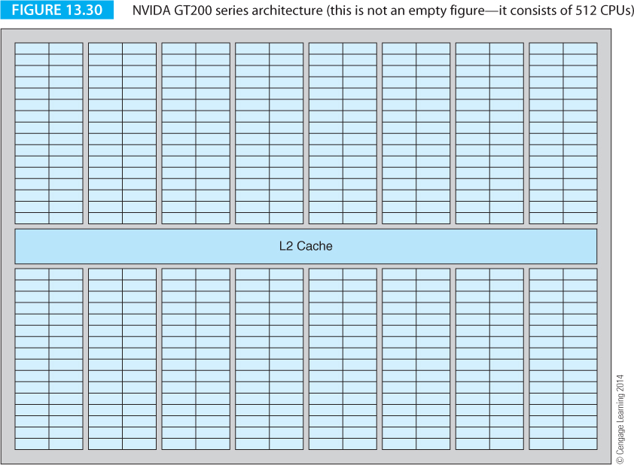
Computer Organization and Architecture: Themes and Variations, 1st Edition Clements
In 2008 NVIDIA introduced the GT2000 series that increased the number of streaming processor cores to 240. Figure 13.30 describes the organization of the cores in a 512-core version of the GPU. Each core can execute a new integer or floating-point instruction at each clock. The cores are organized as 16 groups, called streaming multiprocessors (SMs) of 32 cores. A part of the GPU called the GigaThread global scheduler is responsible for allocating blocks of threads

Slide 81
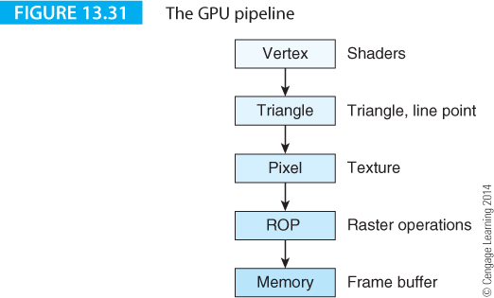
Computer Organization and Architecture: Themes and Variations, 1st Edition Clements
The source image is presented to the graphics card as triangles, the fundamental component of a video image. The higher the resolution, the greater the number of triangles. The triangles are transmitted as vertices.
The GPU processes the vertices and then operates as a pipeline with each stage performing successive transformations on the image. Figure 13.31 illustrates the graphics pipeline. Another operation taking place in the pipeline is the generation of lighting effects.

Slide 82
Computer Organization and Architecture: Themes and Variations, 1st Edition Clements
Heterogeneous Multiprocessors
In 2007 Kumar, Tullsen and Jouppi stated that
Heterogeneous chip multiprtocessors represent unique operatunutes for improving system throughpu, reduccing processor power, and miticgating Amdahl’s law.
On-chip herteogenity allows the processor to better match execution resources to each application’s needs and to adress a much wider spectrum of system loadad-from low to high thread parallelism-with high efficiency.
Heterogeneous multiprocessing permits the use of multi-ISA architectures with individual software being targeted on the most appropriate ISA on the chip. Here, we look at an example of the heterogeneous multiprocessor.

Slide 83
Computer Organization and Architecture: Themes and Variations, 1st Edition Clements
The Cell Architecture
The Cell Broadband Engine Architecture, Cell, is a microprocessor architecture developed by a consortium, STI, of Sony, Toshiba, and IBM.
Cell was developed to overcome the three walls of computer architecture: the power wall, the frequency wall, and the memory wall.
The Cell processor used in the PlayStation 3 has 234 million transistors, which is comparable with the Itanium 2 developed at approximately the same time.
Cell takes an unusual approach to multiprocessing by employing different architectures on the same chip; that is, the Cell is said to be a heterogonous processor.

Slide 84
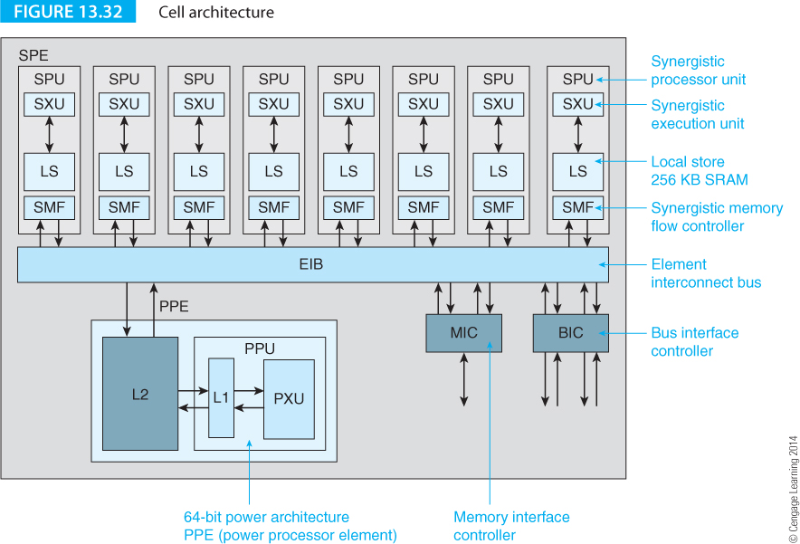
Computer Organization and Architecture: Themes and Variations, 1st Edition Clements
The organization of the Cell is given in Figure 13.32. The main processor is a Power Processing Element that is compatible with IBM’s Power 970 architecture.
This has a split L1 cache with 32 KB data and 32 KB instruction, and a 512 KB level 2 cache. It incorporates the AltiVec instruction set extensions to provide SIMD multimedia support. The SIMD processor has 32 128-bit vector registers.

Slide 85
Computer Organization and Architecture: Themes and Variations, 1st Edition Clements

Slide 86
Computer Organization and Architecture: Themes and Variations, 1st Edition Clements
As well as the central Power Processing Element the Cell has eight Synergistic Processor Elements, SPEs, arranged as a network with a high-bandwidth internal interconnect bus, EIB. This bus is also connected to an interface to external memory and an I/O controller.
The data bus itself consists of four 16-byte wide data rings that support multiple simultaneous transfers per ring. The peak bandwidth is 96 bytes per clock cycle. The EIB can sustain a data rate of 200 GB/s.
The eight SPEs are special purpose RISC-based SIMD processors optimized for data-rich operations. The SPEs each have 128 registers in a 128-bit register file and 256 KB of local store.
SPEs process applications level data and do not run the operating system; that’s the function of the power processor element core, PPE.
Most instructions operate on 128 bit operands divided into four 32-bit words. This fits in well with the Cell’s role as a high-performance multimedia processor and its role in PlayStation 3.

Slide 87
Computer Organization and Architecture: Themes and Variations, 1st Edition Clements
Networks on a Chip
In 2011 the Wikipedia entry for Network on a Chip (NoC) called it an emerging paradigm that links multiple processor cores on a chip with multiple point-to-point routes.
The NoC represents the next stage in multicore processors with more processing units than the first generation of multicore processors and with more complicated inter-processor communication methods.
There is an overlap between NoC and SoC; the latter refers to a system on a chip and implies a single chip solution to an engineering problem that may include multiple CPUs, memory, I/O and special-purpose circuits that might be necessary in cell phones or GPS receivers.
A SoC is normally intended for a specific purpose, where as a NoC is a general-purpose processing device.

Slide 88
Computer Organization and Architecture: Themes and Variations, 1st Edition Clements
In 2007 Intel announced its NoC processor, the Teraflops Research Chip that was to be the first general-purpose microprocessor to break the teraflops barrier.
This terascale processor was intended to lead Intel’s research into the area of multicore processing well beyond the modest number of cores in the i7 and to achieve a lower power/core than existing processors.
Teraflops uses an 80-core tiled architecture with a two-dimensional mesh of cores, each implemented with 100 million transistors using a 65 nm process technology.
Teraflops is a research vehicle and a platform for processor evaluation rather than a commercial processor. The cores or tiles are arranged as an 8 x 10 array.

Slide 89
Computer Organization and Architecture: Themes and Variations, 1st Edition Clements
Each Teraflops tile has two floating-point units, 3 KB of instruction memory arranged as 256 96-bit instructions, and 2 KB of data memory sufficient to hold 512 single-precision numbers.
The register file has 32 entries with six read ports and four write ports.
The floating-point units, FPMAC0 and FPMAC1 are two independent, fully-pipelined, single-precision, floating-point, multiply-accumulate devices that can provide a peak performance of 20 GFLOPS.
Teraflops is not intended for conventional programming. It is optimized for scientific computing and graphics.
The underlying ISA is VLIW, with 96-bit instructions.
Each long instruction word contains eight operations (i.e., an instruction bundle has 8 instructions). The instruction set is tiny.

Slide 90
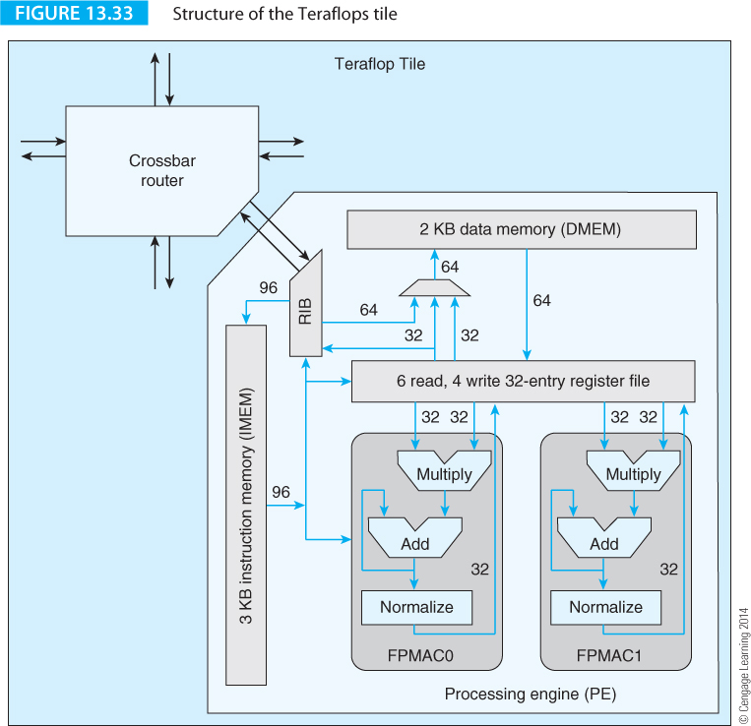
Computer Organization and Architecture: Themes and Variations, 1st Edition Clements
Figure 13.33 gives a diagram of the structure of a Teraflops tile. The communications unit is a 5-port packet-switched router that links a tile to its four neighbors and to the clock.

Slide 91
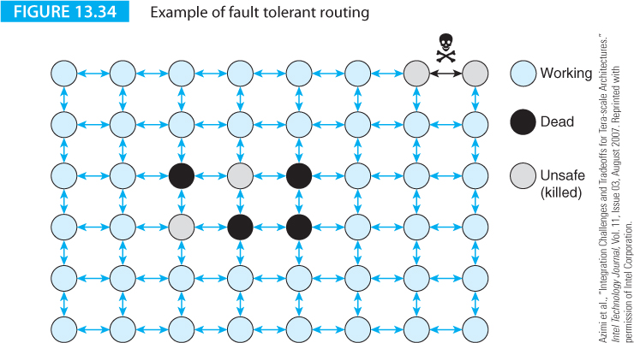
Computer Organization and Architecture: Themes and Variations, 1st Edition Clements
Tiling provides fault tolerance and for graceful degradation. If one or more tiles fail, they can be switched out and tasks assigned to good tiles.
Figure 13.34 provides an example of fault-tolerant routing. At reset and initialization time, all the tiles in the array can be individually tested.

Slide 92
Computer Organization and Architecture: Themes and Variations, 1st Edition Clements
Errors may be present in tiles or in the links between tiles. Figure 13.34 illustrates an array with four dead tiles and a faulty link.
Several nodes have been marked as unsafe. These are removed from the array. In the center, they are removed to make the region containing the dead tiles a reactance in order to simplify routing algorithms. The two unsafe tiles at the top right hand corner have been removed because of the faulty link.

