Slide 1


Chapter 5
Computer Organization and Architecture: Themes and Variations, 1st Edition Clements
Computer Organization and Architecture

Slide 2
Computer Organization and Architecture: Themes and Variations, 1st Edition Clements
Computer Architecture and Multimedia
The rise of the RISC processor in the 1980s seemed poised to sweep away complex instruction set architectures. Complex operations were to be carried out as fast sequences of primitive operations.
However, complex instructions did not disappear. The rise of multimedia applications demanded new levels of performance and special operations were developed to facilitate audio and video processing.
These new operations became known as instruction set extensions.

Slide 3
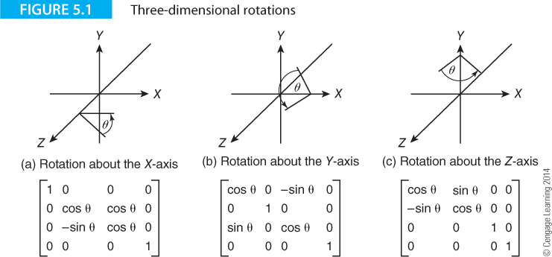
Computer Organization and Architecture: Themes and Variations, 1st Edition Clements
Background
We begin by demonstrating why extended instruction sets have been developed.
Figure 5.1 illustrates the matrix operations required to perform the rotation of a point in 3D space. These operations are intrinsically simple (multiplication and addition). However, very large numbers of these operations are required.

Slide 4
Computer Organization and Architecture: Themes and Variations, 1st Edition Clements
A particular feature of multimedia operations is that the data elements are small – typically 8 or 16 bits.
Today, the host computer can usually perform 64 bit operations.
In other words, a 64-bit processor performing multimedia operations is often using only 16 bits and throwing away 56 bits of the word.
Multimedia operations improve performance by using all the 64 bits of a register.

Slide 5
Computer Organization and Architecture: Themes and Variations, 1st Edition Clements
Example
We can improve some images by emphasizing their edges in a process called edge enhancement; this is often called sharpening by image processing packages.
One way of performing edge enhancement is to take an m x m matrix of pixels centered on a given pixel, and multiply the matrix by a matrix that enhances contrast. A typical edge-enhancing matrix is:
-1 -1 -1
-1 9 -1
-1 -1 -1
Once again, we have an intrinsically simple operation involving multiplication and addition that is applied to many pixels.

Slide 6
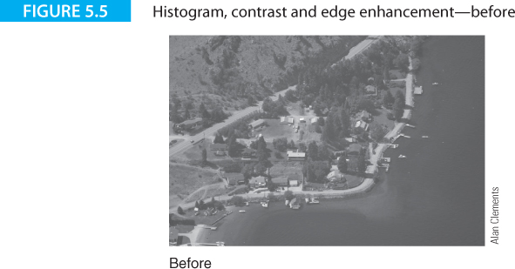
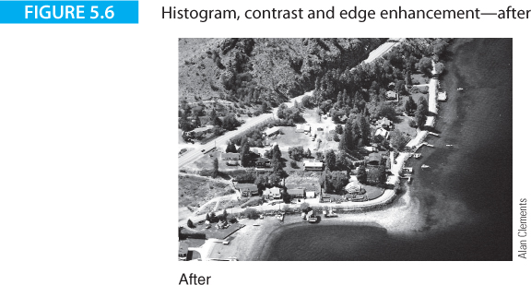
Computer Organization and Architecture: Themes and Variations, 1st Edition Clements
This is an example of image processing.
Large numbers of simple operations can be used to improve the contrast of an image.

Slide 7
Computer Organization and Architecture: Themes and Variations, 1st Edition Clements
Digital Signal Processing
Let’s take a short detour and introduce digital signal processing.
Digital signal processing, DSP, is referred to in the joint ACM/IEEE Computing Curriculum 2005 as “The field of computing that deals with digital filters, time and frequency transforms, and other digital methods of handling analog signals.”
DSP is not a topic normally covered in computer architecture texts, and DSP is all but invisible to most students taking CS and IT degrees.
DSP is probably the most important of all computing applications in today’s world

Slide 8
Computer Organization and Architecture: Themes and Variations, 1st Edition Clements
DSP covers the branch of computer science (computer engineering) that deals with the processing and interpretation of signals from electrocardiograms (EKGs), MRI scanners, seismometers, ultrasound scanners, oil rigs (when exploring), and so on.
These are applications that are vital to the world’s economy and to our health-care systems.
DSP has its origins in the 1960s when the adaptive equalizer was designed to maximize the bandwidth of transmission paths across the global analog-based telecommunications network of the 1960s and 70s.
In the 1960s high-speed wide bandwidth optical transmission lines didn’t exist and public switched telephone data links had a bandwidth of only 3000 Hz.

Slide 9
Computer Organization and Architecture: Themes and Variations, 1st Edition Clements
A DSP system uses a sequence of sampled values of a signal; for example, the signal level of an analog signal such as music, picked up by a microphone and sampled at over 40,000 times a second.
These samples can be multiplied by constants and variables and delayed in unit delay blocks.
A delay is equal to one clock period. The mathematical operator that denotes a delay is written z⁻¹.
If you were to write an expression in Z-transform notation
y_{i} = 0.8x_{i} + 0.2x_{i-1}z⁻¹ + 0.1x_{i-2}z⁻²
it would indicate that the i^{th} value of the output, y_{i}, is given by 0.8 multiplied by the i^{th} value of the input x_{i} plus 0.2 of the input before that, x_{i-1}, plus 0.1 of the input before that, x_{i-2}.

Slide 10
Computer Organization and Architecture: Themes and Variations, 1st Edition Clements
DSP Applications
Digital signal processing is one of the most ubiquitous of all modern digital technologies.
DSP is carried out by conventional processors, dedicated special-purpose processors optimized for DSP applications, or FPGAs (field programmable gate arrays). Typical DSP applications are:
Cellular phones
Digital pagers
Audio systems, MP3, AAC decoding, equalization, sound effects).
HDTV (High definition television)
Automobile control (active suspension, engine control, anti-skid)
Disk drives (digital filtering for pulse detection)
Active noise cancellation

Slide 11
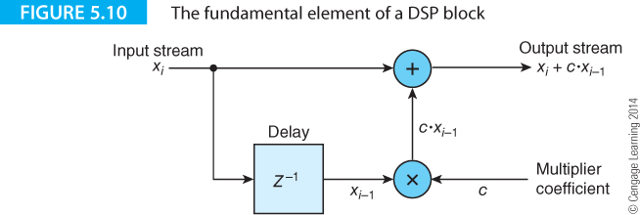
Computer Organization and Architecture: Themes and Variations, 1st Edition Clements
The basic DSP building block of Figure 5.10 can be used to construct digital filters that transmit or stop a range of frequencies; for example, you could use a digital filter with an EKG to separate out the heartbeat of a fetus from that of the mother.
There are two classic forms of digital filter; Figure 5.11 illustrates the finite impulse response filter, FIR, and Figure 5.12 illustrates the infinite impulse response filter, IIR.

Slide 12
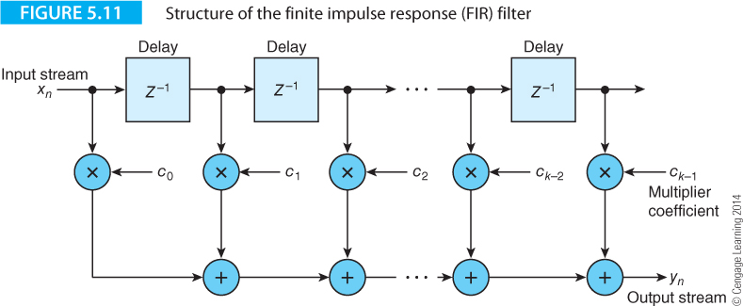
Computer Organization and Architecture: Themes and Variations, 1st Edition Clements

Slide 13
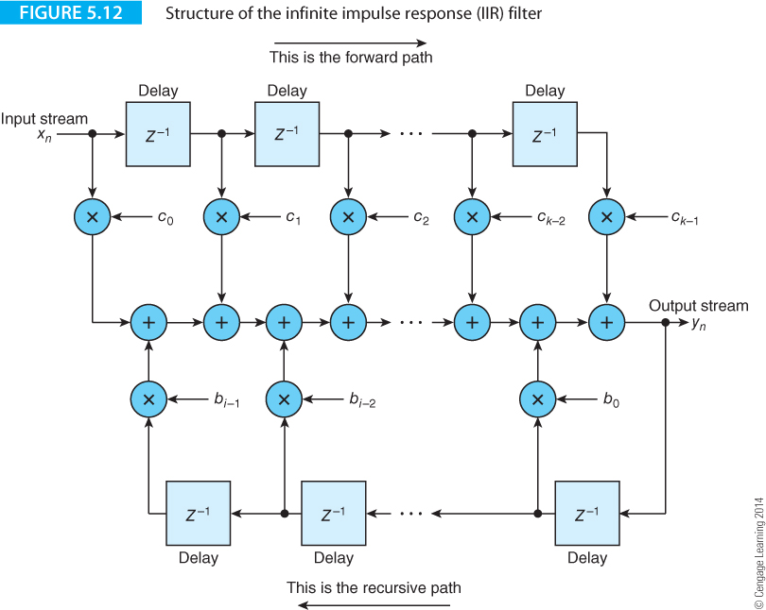
Computer Organization and Architecture: Themes and Variations, 1st Edition Clements

Slide 14

Computer Organization and Architecture: Themes and Variations, 1st Edition Clements
DSP Architectures
Recall that digital filters are synthesized by evaluating
$$y_{i}=\sum{x_{j}}∙a_{i−j}$$
The key action in this calculation is the repeated multiplication of pairs of numbers and their summation which suggests that multiply-accumulate operations (MACs) similar to the ARM’s MLA would feature prominently in any dedicated DSP architecture.
Similarly, the variable subscripts imply that the ability to handle vectors is vital and that the vectors should be able to model long sequences of sample values (the data streams).

Slide 15
Computer Organization and Architecture: Themes and Variations, 1st Edition Clements
DSP Architectures
In the 1980s semiconductor manufacturers introduced the first generation of dedicated DSP processors; for example, TI introduced the TSM32010 programmable integer DSP chip operating at 5 MIPS, and Motorola introduced the 56000 family in the 1980s.
Table 5.2 gives some of the features of these two first-generation DSPs.
Feature | TI TSM32010 family | Motorola 56000 family
Data | 16-bit (accumulator 32-bit) | 24-bit (accumulator 56-bit)
Architecture | Harvard | Harvard
Arithmetic | Fixed-point | Fixed-point
Instruction set | Multiply-accumulate | Multiply-accumulate

Slide 16
Computer Organization and Architecture: Themes and Variations, 1st Edition Clements
Dedicated digital signal processors are designed for high-volume low-cost applications and that implies that they are highly optimized (if they were not, they would not have a significant advantage over conventional processors). The principal features of DSP architectures are:
Specialized instruction set – support for multiply and accumulate
Harvard architecture – separate instruction and data paths
Multiples buses
Multiple memory banks
Special-purpose memory access (e.g., buffers) to synthesize delays
Support for auto incrementing addressing and circular modes
Lack of multiuser OS support and memory management facilities
16-bit or 24-bit fixed point arithmetic
No cache memory
DSP processors have both dedicated architectures and dedicated instruction sets. Multimedia extensions are an attempt to add some DPS features to conventional microprocessor ISAs.

Slide 17
Computer Organization and Architecture: Themes and Variations, 1st Edition Clements
SIMD Operations
Single instruction multiple data, SIMD, indicates that a single operation is applied to several data elements in parallel.
Consider a 64-bit register with four 16-bit elements that can be added to another four elements in one operation.

Slide 18
Computer Organization and Architecture: Themes and Variations, 1st Edition Clements
In 1996 Intel announced a multimedia extension technology, called MMX, that added innovative architectural features to the IA32 architecture.
This move was surprising in that Intel was increasing instruction set complexity when the trend was in the other direction.
It made good sense to incorporate facilities that would give the IA32 a strongly competitive edge.
Since then, each new generation of a microprocessor family has added special-purpose multimedia friendly instructions to its core of existing instructions.

Slide 19
Computer Organization and Architecture: Themes and Variations, 1st Edition Clements
Table 5.3 illustrates some of the processors with multimedia extensions.
Processor | Vector Extension Name
Sun UltraSPARC | VIS (Visual Instruction Set)
Hewlett-Packard PA-RISC | MAX (Multimedia Acceleration eXtensions)
Intel Pentium | MMX (MultiMedia eXtensions)
Intel Pentium | SSE (Streaming SIMD extensions)
Intel Core i7 | SSE4 (Streaming SIMD extensions)
Intel Sandy Bridge processor | AVX (Advanced Vector Extensions)
Silicon Graphics | MDMX (MIPS Digital Media eXtension)
Digital Alpha | MVI (Motion Video Instructions)
PowerPC | AltiVec
AMD K6-2 | 3Dnow!
AMD | XOP, FMA4, CVT16
ARM | NEON
MIPS | DSP ASE

Slide 20
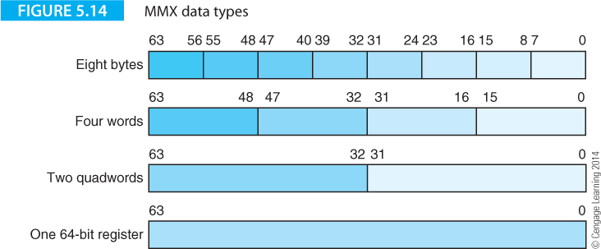
Computer Organization and Architecture: Themes and Variations, 1st Edition Clements
Introduction to SIMD Processing
Intel’s multimedia extensions provide the IA32 architecture with a SIMD facility that lets you apply a single instruction to multiple data elements; for example, you can multiply four pairs of 8-bit integers in parallel or simultaneously add eight pairs of bytes.
Figure 5.14 illustrates the new data types which are all 64-bit values in registers MM0 to MM7.

Slide 21
Computer Organization and Architecture: Themes and Variations, 1st Edition Clements
An MMX register can be partitioned into 8-bit values, 16-bit values, or 32-bit values. MMX mnemonics are prefixed by P to indicate a packed operation; for example, the PADD instruction performs a packed add.
The suffix b, w, or d indicates a byte, word, or doubleword operation; for example, a PADDb MM0,MM1 instruction simultaneously adds together eight pairs of bytes in register MM1 to the eight bytes in register MM0 and deposits the eight sums in MM0. Consider:
PADDb MM0,MM1
or PSUBw MM3,MM0.

Slide 22
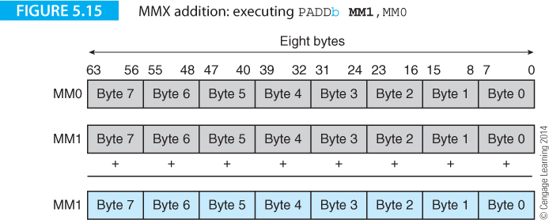
Computer Organization and Architecture: Themes and Variations, 1st Edition Clements
Figure 5.15 illustrates the effect of PADDb MM1,MM0 where eight pairs of bytes in two MMX registers are added together simultaneously.
Since the eight additions in a packed MMX addition take place simultaneously, an 8-bit vector is required to hold the eight carry bits generated by the additions.

Slide 23
Computer Organization and Architecture: Themes and Variations, 1st Edition Clements
Saturating arithmetic
A particularly interesting aspect of MMX instructions is their treatment of overflow and underflow in integer arithmetic.
Conventional integer arithmetic uses a wraparound mode where, for example, in eight bits the addition of 1 to 11111111 results in 00000000 and a carry out.
The term wraparound indicates that the maximum value wraps around to the minimum value.
MMX instructions can operate in a conventional wraparound mode, but this does not model well the physical reality of multimedia operations.

Slide 24
Computer Organization and Architecture: Themes and Variations, 1st Edition Clements
Suppose we use an 8-bit value to represent the intensity of a blue pixel.
If 11111111 represents the brightest blue and 00000000 represents no blue, the physical reality is 11111111 + 1 = 11111111; that is, you can’t get bluer than blue. Similarly, 00000000 – 1 is 00000000 because you can’t get less blue than no blue.
In both cases, the maximum or minimum value is constrained during arithmetic operations.
This philosophy of clamping a value at its maximum or minimum corresponds well to physical reality. If you are representing part of a scene that is fully white, you can’t make it even whiter.
Operations that clamp a value at its limits and don’t permit wraparound are called saturating operations.

Slide 25
Computer Organization and Architecture: Themes and Variations, 1st Edition Clements
All MMX instructions except for multiplication take place in a single cycle. Some MMX operations may operate in a wraparound or a saturated mode.
If the operation is both signed and saturated, the upper and lower values are 7F₁₆ and 80₁₆ (in byte arithmetic).
If the operation is unsigned and saturated, the upper and lower values are 00₁₆ and FF₁₆ (in byte arithmetic).
Consider the unsigned byte addition operation, PADDusb MM0,MM1, where the initial vales in MM0 and MM1 are
77012345F0AAF01F and 11FFEE00002387CE

Slide 26
Computer Organization and Architecture: Themes and Variations, 1st Edition Clements
In PADDusb the u indicates unsigned, s indicates saturating arithmetic, and b indicates byte operands. If we split the hexadecimal digits into eight groups of two, we can perform the additions and record any sum that exceeds FF₁₆ as FF₁₆.
77 01 23 45 F0 AA F0 88
+11 FF FF 00 7A 23 87 CE
88 FF FF 45 FF CD FF FF

Slide 27
Computer Organization and Architecture: Themes and Variations, 1st Edition Clements
The sum of four pairs of numbers exceeds FF₁₆ and the result is clamped at FF₁₆.
Now suppose we perform the same operation using signed saturating arithmetic. In this case we get,
77 01 23 45 F0 AA F0 88
+11 FF FF 00 7A 23 87 CE
7F 00 22 45 6A CD 80 80
Values that have saturated at 80₁₆ (most negative) and 7F₁₆ (most positive) are presented in bold face blue.
Later, we demonstrate how saturating arithmetic can be used to perform clipping without using branch instructions.

Slide 28
Computer Organization and Architecture: Themes and Variations, 1st Edition Clements
Here’s an example of branchless arithmetic that uses saturating arithmetic to perform an operation that would normally require branching. P, Q, and R are 8 byte vectors and we wish to calculate the absolute value P = |Q – R|. Conventionally, we can write
IF (Q > R)
THEN P = Q – R
ELSE P = R – Q
This algorithm can be implemented efficiently using saturating arithmetic.
If we perform both subtractions Q – R and R – Q, the operation that results in a positive value gives the correct result. However, the operation that yields a negative value results in zero due to the saturation arithmetic limiting the value to zero.

Slide 29
Computer Organization and Architecture: Themes and Variations, 1st Edition Clements
Since one of these operations yields a positive result and the other yields a zero result, ORing the two values together yields the correct result.
If MM0 contains P and MM1 contains Q, we can write
MOVQ MM2,MM0 ;make a copy of P in MM2
PSUBusb MM0,MM1 ;compute difference P – Q; 0 if P < Q
PSUBusb MM1,MM2 ;compute difference Q – P; 0 if Q < P
POR MM0,MM1 ;OR differences (one of which is 0)

Slide 30
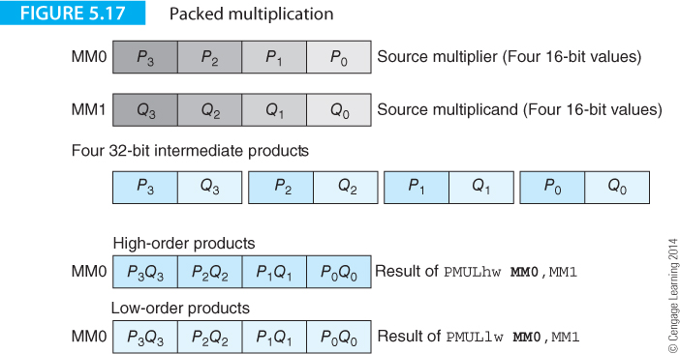
Computer Organization and Architecture: Themes and Variations, 1st Edition Clements
Packed Multiplication
The MMX architecture provides two types of multiplication: a conventional multiplication instruction that forms the products of pairs of numbers in parallel and a powerful multiply and add operation that forms the sum of products.

Slide 31
Computer Organization and Architecture: Themes and Variations, 1st Edition Clements
The PMULhw and PMULlw instructions each multiply four signed, packed, 16-bit words to generate four 32-bit products.
Because four double-length 32-bit products will not fit in a 64-bit MMX register, you must use PMULhw to select the upper-order 16-bits of each product or PMULlw to select the lower-order 16-bits of each product.
Figure 5.17 demonstrates the effect of these two instructions on the contents of two MMX registers.
Note how the MMX instruction set provides more options for add and subtract instructions (8- to 32-bit additions), whereas the multiplication instructions are constrained to 16-bit signed arithmetic.

Slide 32
Computer Organization and Architecture: Themes and Variations, 1st Edition Clements
The packed multiply and add instruction, PMADDwd, also multiplies four pairs of signed 16-bit words.
However, the two pairs of adjacent 32-bit products are added together to create two 32-bit sums.
If the source words are P₃, P₂, P₁, P₀ and Q₃, Q₂, Q₁, Q₀, the products are P₃⋅Q₃, P₂⋅Q₂, P₁⋅Q₁, P₀⋅Q₀.
The adjacent pairs of products are then summed to get
P₃⋅Q₃+ P₂⋅Q₂, P₁⋅Q₁+ P₀⋅Q₀.
Figure 5.18 describes this operation.

Slide 33
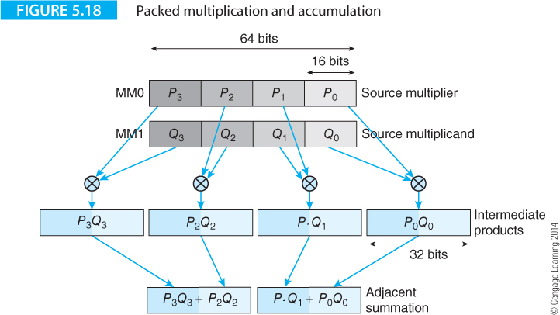
Computer Organization and Architecture: Themes and Variations, 1st Edition Clements

Slide 34
Computer Organization and Architecture: Themes and Variations, 1st Edition Clements
Parallel Comparison
MMX instructions allow you to compare two values, although both the way in which values are compared and how you use the results of the comparison is anything but conventional.
Because the MMX architecture doesn’t modify the IA32’s architectural state, the result of a test cannot be permitted to set one of the processor’s flags.
Consequently, any test or comparison has to operate by setting or clearing the bits of a register.
Moreover, since the MMX is operating on words in parallel, the nature of a vector comparison is different to a scalar comparison because there are multiple results.

Slide 35
Computer Organization and Architecture: Themes and Variations, 1st Edition Clements
The MMX architecture provides two comparison instructions, one that performs a comparison for equality, and the other provides a greater than test.
Intel has adopted an interesting approach to testing.
Instead of setting a flag bit in a status register, the outcome of an MMX test either fills the destination operand with all zeros or with all ones.
The condition true yields all ones, and the condition false yields all zeros; for example, the test of equality with the values 5 and 9 would yield 00000000 (in a byte comparison) whereas a test with the values 7 and 7 would yield 11111111.
In other words, the outcome of a comparison is a data value rather than a flag value.

Slide 36
Computer Organization and Architecture: Themes and Variations, 1st Edition Clements
Packing and Unpacking
Packing and unpacking instructions are provided to perform conversions between data sizes; that is, 32 bits to 16 bits, or 16 bits to 8 bits.
As its name suggests, the pack instruction packs data into an MMX register by converting words into bytes (or doublewords into words).
When data is packed, it loses precision and may have to be truncated using either signed or unsigned saturating arithmetic.
The pack with signed saturating arithmetic instruction PACKss packs and saturates the signed data elements from the source and the destination operands and writes the signed results to the destination operand (the signed, saturated mode is the only option with this instruction).

Slide 37
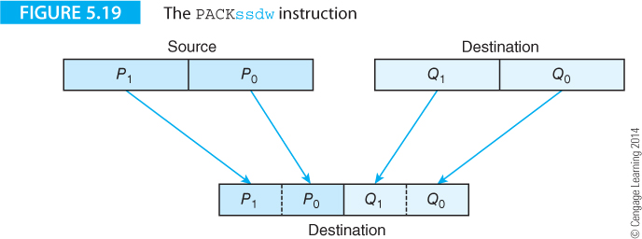
Computer Organization and Architecture: Themes and Variations, 1st Edition Clements
The PACKssdw instruction packs two signed 32-bit words from the source operand and two signed words from the destination operand into four signed 16-bit values in the destination register as Figure 5.19 demonstrates.
If the signed value of a word is larger or smaller than the valid range of a signed 16-bit integer, the value is saturated and clamped at 7FFF₁₆, if it is positive, or 8000₁₆ if it is negative.

Slide 38
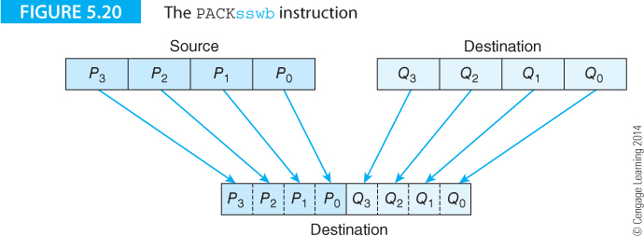
Computer Organization and Architecture: Themes and Variations, 1st Edition Clements
Figure 5.20 demonstrates the PACKsswb version of this instruction that packs two signed words from the source operand and two signed words from the destination operand into four signed bytes in the destination register.
In this case, the saturated values are clamped at 7F₁₆ (positive) or 80₁₆ (negative)

Slide 39
Computer Organization and Architecture: Themes and Variations, 1st Edition Clements
The inverse operation to packing is unpacking, where data is expanded.
However, the PUNPCK instruction is not a simple inverse of the parallel pack instruction.
The parallel unpack instruction should really be thought of as a parallel merge instruction that operates with three data sizes: byte-to-word (bw), word-to-doubleword (wd), and doubleword-to-quadword (dq).
When a word is unpacked, it occupies twice the number of bits.
Each MMX instruction allows you to unpack from either the upper half of a word or the lower half of a word.
Consequently, there are six variations on the unpack instruction

Slide 40
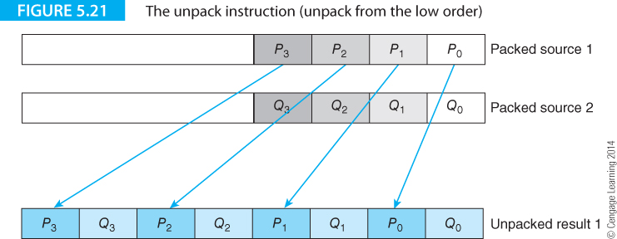
Computer Organization and Architecture: Themes and Variations, 1st Edition Clements
Figure 5.21 demonstrates the effect of the PUNPCKlbw instruction that unpacks bytes to words.
Here, two MMX registers containing four bytes (in the low-order half of the register) are unpacked and the eight bytes placed in the destination register.

Slide 41
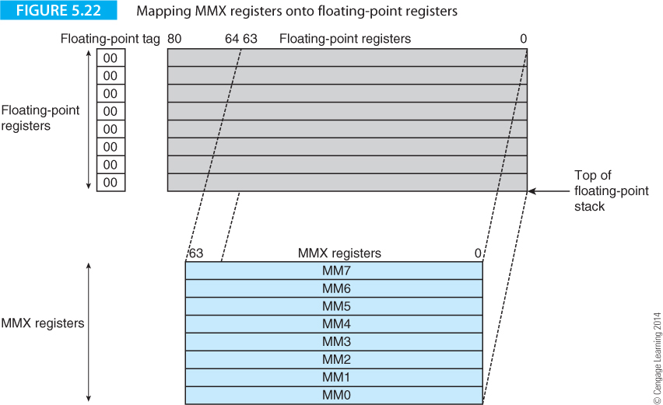
Computer Organization and Architecture: Themes and Variations, 1st Edition Clements
Coexisting with Floating-point
MMX technology uses the IA32’s existing floating-point registers. This is called register aliasing because the same registers are known by two names (floating-point and MMX). Figure 5.22 illustrates the relationship between the floating-point and MMX registers.

Slide 42
Computer Organization and Architecture: Themes and Variations, 1st Edition Clements
Applications of SIMD Technology
The following matrix represents a transformation that involves rotation and scaling, translation, and a change of perspective.
Consider the new value of x’ = a₀x +a₁y + a₂z + a₃w. The calculation of x’ requires four multiplications and three additions. Using MMX instructions we can write
PMADDwd MM0,MM1 ;perform a₀x +a₁y and a₂z + a₃w
to perform four multiplications and two additions with one instruction.

Slide 43
Computer Organization and Architecture: Themes and Variations, 1st Edition Clements
Applications of SIMD Technology
The following matrix represents a transformation that involves rotation and scaling, translation, and a change of perspective.
Consider the new value of x’ = a₀x +a₁y + a₂z + a₃w. The calculation of x’ requires four multiplications and three additions. Using MMX instructions we can write
PMADDwd MM0,MM1 ;perform a₀x +a₁y and a₂z + a₃w
to perform four multiplications and two additions with one instruction.

Slide 44
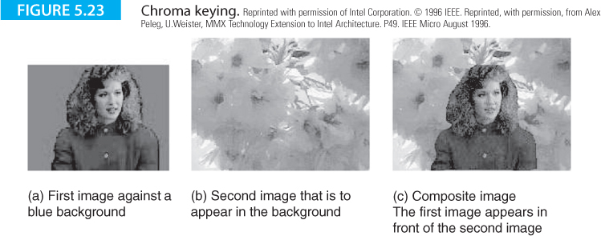
Computer Organization and Architecture: Themes and Variations, 1st Edition Clements
Chroma Keying
Chroma keying is a video technique that lets you merge two images; for example, we see it in action every day when the weather forecaster stand in front of a synoptic chart that we know is not actually there.
Figure 5.23 demonstrates the effect of chroma keying. Figure 5.23a shows the image of a woman and Figure 5.23b shows the image of a flower. In Figure 5.23c the image of the woman has been superimposed on that of the flower. It’s as if the woman were standing in front of the flower. These images are reproduced here in monochrome. The woman is sitting in front of a blue background.

Slide 45
Computer Organization and Architecture: Themes and Variations, 1st Edition Clements
Although chroma keying looks as if it requires some applied magic, it’s achieved by a remarkably simple trick.
The woman in Figure 5.23 is placed against a dark blue background. If this image is scanned and converted into pixels, a pixel will either be blue (the background) or not blue (part of the desired image to be superimposed).
If any part of the woman’s image is the same color as the blue background, part of the second image will bleed through.
To form the composite image, we just read a pixel from image (a) and the corresponding pixel from image (b) and then determine the final pixel for the composite image (c) as:
if pixel_{a} = blue then pixel_{c} = pixel_{b}
else pixel_{c} = pixel_{a}

Slide 46
Computer Organization and Architecture: Themes and Variations, 1st Edition Clements

Slide 47
Computer Organization and Architecture: Themes and Variations, 1st Edition Clements
SIMD instructions used in the following example
MOVEq MM3,image1 ;Load an MMX register from memory.
The q denotes quad 64 bits
MOVEq MM4,image2
PCMPEQb MM1,MM3 ;A parallel compare for equality over the
;8 bytes in two MMX registers.
;When two bytes are equal, 0xFF is loaded into
;the destination register.
;If they are unequal, the value 0x00 is loaded.
PAND MM4,MM1 ;An AND is performed between the two 64-bit
;registers
PANDN MM1,MM3 ;Perform an AND and invert the result.
POR MM4,MM1 ;OR the two 64-bit registers

Slide 48
Computer Organization and Architecture: Themes and Variations, 1st Edition Clements
Using SIMD extensions we can process groups of eight pixels in parallel.
;initially MM1 contains eight blue pixels
MOVEq MM3,image1 ;read 8 pixels from the woman’s image into MM3
MOVEq MM4,image2 ;read 8 pixels from the flower image into MM4
PCMPEQb MM1,MM3 ;compare woman’s image with blue pixels to create
;a mask
PAND MM4,MM1 ;retain image of flower where image 1 is blue
PANDN MM1,MM3 ;retain image of woman where image 1 is not blue
POR MM4,MM1 ;combine the two images
These instructions process eight pixels in just six machine cycles.
Figure 5.24 demonstrates the effect of PCMPEQb MM1,MM3, where MM1 initially contains the blue mask used to mask out the woman in image 1.
That is, each pixel in MM1 is set to the same value as the blue background.

Slide 49
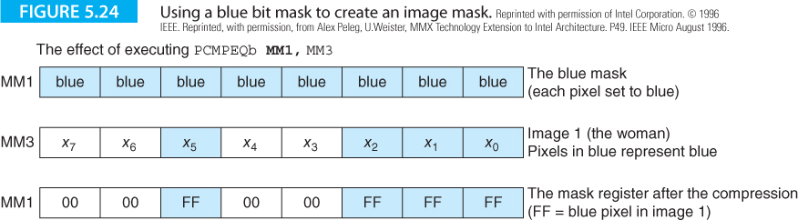
Computer Organization and Architecture: Themes and Variations, 1st Edition Clements

Slide 50
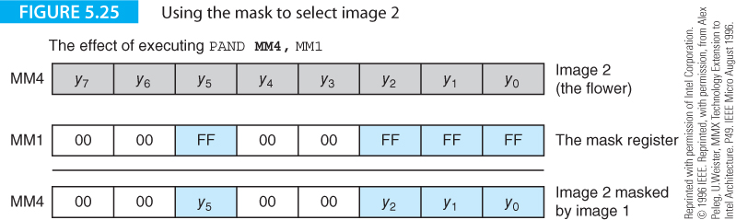
Computer Organization and Architecture: Themes and Variations, 1st Edition Clements
After the parallel compare instruction, PCMPEQb MM1,MM3, has been executed, register MM1 contains a bit mask. The bits in each byte are all ones if the pixel from image 1 was part of the blue background, or the bits are all zeros if the pixel was part of the woman.
Figure 5.25 demonstrates how we use the mask register with image 2 to mask out the bits of image 2, the flower, where the corresponding bits of image 1 are not blue. The PAND MM4,MM1 instruction retains bits in register MM4 when the corresponding mask bits are 1. At the end of this operation, the pixels in MM4 correspond to the flower where the background in image 1 is blue.

Slide 51
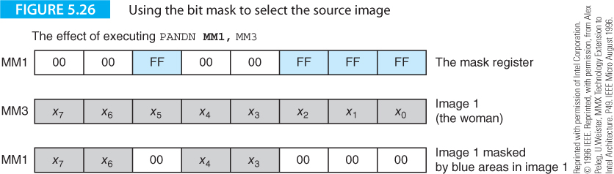
Computer Organization and Architecture: Themes and Variations, 1st Edition Clements
Figure 5.26 uses the negated AND operation, PANDN MM1,MM3, to copy pixels of image 1 for which the corresponding mask bits are 0. At the end of this operation register MM1 contains pixels from the image of the woman with zeros where the background was blue.
Having now created the two partial images with 0s where pixels are masked out, we can merge these images with a logical OR operation, POR MM4,MM1, as Figure 5.27 demonstrates.

Slide 52
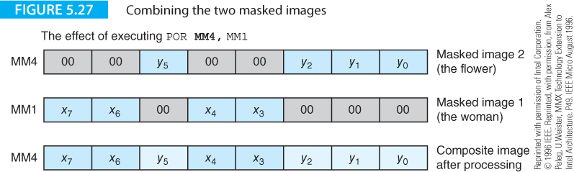
Computer Organization and Architecture: Themes and Variations, 1st Edition Clements

Slide 53
Computer Organization and Architecture: Themes and Variations, 1st Edition Clements
Fade In and Out
Another video processing application that can make good use of SIMD extensions is image combining or image merging.
Most people are familiar with the dissolve shot on video where one image gradually fades out while another image fades in.
If we combine image_{A} (the old image) with image_{B} (the new image) we get:
output = fade x image_{A} + (1 – fade) x image_{B}
We re-label image_{A} as A and image_{B} as B and rearrange the equation to get
output = fade x (A – B) + B

Slide 54
Computer Organization and Architecture: Themes and Variations, 1st Edition Clements
PXOR MM7,MM7 ;set MM7 to 0 (we need a dummy 0 later)
MOVq MM3,fade ;load fade value (replicated in 4 words)
MOVd MM0,imageA ;load pixels from source image A
MOVd MM1,imageB ;load pixels from source image B
PUNPCKlbw MM0,MM7 ;unpack 8-bit pixels as words in MM0
PUNPCKlbw MM1,MM7 ;unpack 8-bit pixels as words in MM1
PSUBw MM0,MM1 ;subtract image B from image A
PMULhw MM0,MM3 ;multiply difference by the fade value
PADDwq MM0,MM1 ;add result to B to get fade x (A – B) + B
PACKUSwb MM0,MM7 ;repack 16-bit results to byte get
;output = fade x (A – B) + B

Slide 55
Computer Organization and Architecture: Themes and Variations, 1st Edition Clements
Two MOVd instructions take the pixels from A and B and load them into registers MM0 and MM1 for processing.
The two PUNPACKlbw instructions unpack and expand byte-values to word values. This is necessary because the multiplication operation act only on word values. PUNPACKlbw requires two source operands; in this case, source operand 2 is the dummy register MM7 that contains zero.
Operations PSUBw, PMULhw and PADDwq do the processing work by calculating the new output = fade x image_{A} + (1 – fade) x image_{B}.
The final operation, PACKUSwb, packs the word length values into bytes.
Figure 5.28 illustrates this sequence of operations. Note that this processing applies to only one set of four pixels of one color. We would have to repeat these operations once for each of the three color values (and the alpha value if that is used).

Slide 56
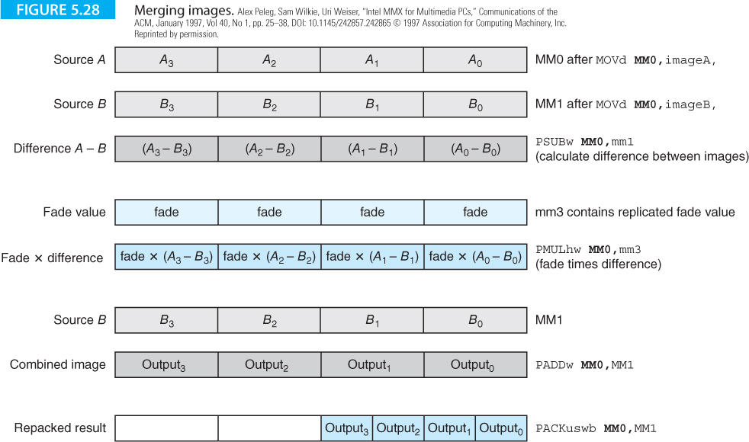
Computer Organization and Architecture: Themes and Variations, 1st Edition Clements

Slide 57
Computer Organization and Architecture: Themes and Variations, 1st Edition Clements
Clipping
An important operation in graphics is clipping that constrains a variable to lie within a fixed range.
For example, if the upper and lower values for a variable X are 4 and 20, then the value of X must always fall within this range.
If X = 15 and we add 7, then we get X = 20 because 20 is the upper limit of X and all higher values are clamped to 20. This operation should remind you of saturating arithmetic.
A constrained value is used in graphics when one image obscures another. Therefore, it’s necessary to know when to clip or hide parts of the obscured background image under the foreground.
If a value x is clipped to be greater than x_{low} and higher than x_{high}, we can write
if x < x_{low} then x = x_{low}
else if x > x_{high} then x = x_{high}

Slide 58
Computer Organization and Architecture: Themes and Variations, 1st Edition Clements
In conventional assembly language terms we might have to write something like the following generic CISC code
CMP x,xLow ;Is x less than lower limit?
BLT FixLow ;If so, then fix it
CMP x,xHigh ;Is x greater than upper limit?
BGT FixHigh ;If too high then fix it
BRA Exit ;If we reach here then in range
FixLow MOV x,x_low ;Constrain to lower limit & exit
BRA Exit
FixHigh MOV x,xHigh ;Constrain to upper limit & exit
Exit

Slide 59
Computer Organization and Architecture: Themes and Variations, 1st Edition Clements
We can do a better job by exploiting ARM’s conditional execution.
Consider the following
CMP r0,#xLow ;Is x less then lower limit?
MOVLT r0,#xLow ;If so then fix at lower limit
CMP r0,#xHigh ;Is x greater than upper limit?
MOVGT r0,#xHigh ;If so then fix at upper limit

Slide 60
Computer Organization and Architecture: Themes and Variations, 1st Edition Clements
SIMD extensions provide a useful means of implementing clipping without using conditional branch operations.
The following fragment of code demonstrates unsigned word clipping to the upper limit high and the lower limit low. The key to clipping is the application of saturating arithmetic.
Figure 5.29 illustrates the relationship between the clipping and saturation limits and demonstrates an example of clipping.
In the following code, the option u indicates unsigned, s indicates saturated and w indicates a word (16-bit) operation.
PADDusw MM0,0xFFFF-high ;clip to high
PSUBusw MM0,0xFFFF-high+low ;clip to low
PADDw MM0,low ;adjust result

Slide 61
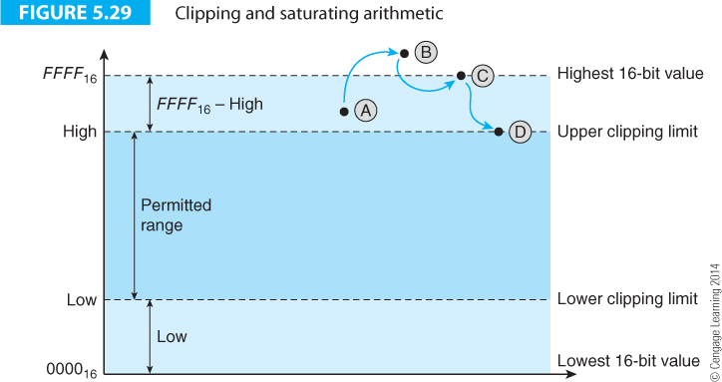
Computer Organization and Architecture: Themes and Variations, 1st Edition Clements

Slide 62
Computer Organization and Architecture: Themes and Variations, 1st Edition Clements
The first instruction PADDusw MM0,0xffff-high adds a constant to the value in MM0 to be clipped. This is the maximum value minus the upper clipping limit. If the number to be clipped is above the upper limit, it is held there by the saturation mechanism.
The second operation performing the same action at the lower limit. The final operation adds back the lower limit that was previously subtracted.
x = x + 0xFFFF - high - 0xFFFF + high - low + low = x
That is, if the value of x is in range, it is unaffected by this chain of operations.
If x is out of range, it is clipped due to the saturation mechanism.

Slide 63
Computer Organization and Architecture: Themes and Variations, 1st Edition Clements
x = x + 0xFFFF – high – 0xFFFF + high – low + low = x
Consider the following example using 4-bit unsigned integer arithmetic with a range 0 to 15.
We will use the clipping limits high = 12 and low = 5. Let’s see what happens with the test cases in Table 5.6
This example demonstrates that the test case of 7 (in range) yields the result 5.
However, the test value 14 is above the maximum range and that yields the clipped result 12.
Similarly, the value 3 is below the lower limit and the clipped result is 5.

Slide 64
Computer Organization and Architecture: Themes and Variations, 1st Edition Clements
Operation | Case 1 | Case 2 | Case 3
Initial value | 7 | 14 | 3
PADDusw MM0,15-12 | 10 | 17 → 15 | 6
PSUBusw MM0,15-12+5 | 2 | 7 | -2 → 0
PADDw MM0,5 | 7 | 12 | 5

Slide 65
Computer Organization and Architecture: Themes and Variations, 1st Edition Clements
Streaming Extensions and the Development of SIMD Technology
Since the introduction of SIMD extensions, development has been continuous, and the handful of MMX extensions has been replaced by generation after generation of new extensions.
However, the basic principles are still the same; the ability to manipulate multiple elements in a single register and to perform operations that are of importance in multimedia or in other domains such as cryptography.
A short time is a long time in the microprocessor world. Intel had hardly launched its MMX architecture before it moved on and introduced its Streaming SIMD Extensions, SSE, in 1999.
Streaming SIMD Extensions first appeared in the Pentium III with two components, integer instructions known as New-media Instructions that operate on the MMX register set, and floating-point SIMD operations that operate on an entirely new set of registers.

Slide 66
Computer Organization and Architecture: Themes and Variations, 1st Edition Clements
To a considerable extent, the Pentium III’s new media instructions are MMX extensions that didn’t make it onto silicon the first time around.
Some of these instructions are extended MMX instructions, and some provide floating-point facilities.
One commentator writing on the introduction of SSE stated it was really Intel’s attempt at getting MMX right the second time round.
You have to appreciate that Intel was locked into a battle with those making IA32 compatible processors such as AMD and that delaying innovation until it was perfect was not an option.
This is probably less true today since Intel appears to have emerged as the undisputed winner in the PC-architecture wars even though AMD is still a major player.

Slide 67
Computer Organization and Architecture: Themes and Variations, 1st Edition Clements
Intel’s Pentium 4 introduced yet a new batch of SIMD Streaming Extensions called SSE2 that extended both the MMX and the SSE architectures by adding 144 new instructions and increasing the number of data types.
The new data types are a 128-bit packed double-precision floating point, a 64-bit quadword integer, and four 128-bit integer data types.
The packed floating-point type allows two IEEE 64-bit double-precision floating-point values to be packed into one double quadword.
The 64-bit quadword integer supports both signed and unsigned values, and the 128-bit integer allows two quadwords, four doublewords, eight words, or 16 bytes integers to be packed into a double quadword.

Slide 68
Computer Organization and Architecture: Themes and Variations, 1st Edition Clements
The double-precision floating-point instructions provide data movement, arithmetic, comparison, conversion, logical, and shuffle ioperations. Floating-point SSE2 instructions can move packed double-precision floating-points and perform arithmetic operations on them, as well as converting between double-and single-precision floating-point formats.
Some of the new integer instructions are PADDQ (packed quadword add), PMULUDQ (unsigned doubleword multiply), PSHUFD (shuffle packed doublewords in an XMM register), and MOVQ2DQ (move integer data from MMX to XMM registers). Existing 64-bit MMX/SSE integer instructions are extended to operate on 128-bit operands in the XMM registers.
Pentium’s new multimedia-friendly SSE2 architecture is rather messy, having picked up so much baggage along the way. You can’t convert MMX code into SSE2 code just by replacing register name MM0 with XMM0, etc. You can’t use MOVQ to access the 128-bit registers; you have to use a MOVAPD instruction instead. Similarly, you have to use new versions of shuffle and shifting instructions.

Slide 69
Computer Organization and Architecture: Themes and Variations, 1st Edition Clements
Intel’s SSE3 and SSE4 Instructions
The Pentium 4E introduced SSE3 extensions in 2004. They use 128-bit registers and add 14 instructions aimed at floating-point to integer conversion, complex arithmetic, video encoding, and thread synchronization.
In 2006 they were extended in the Core Duo with the addition of a further 16 op-codes.
Complex arithmetic is important in digital signal processing applications, particularly in the realm of Fourier transforms. A complex value z is represented by a + bi where i is the square root of ‑1.
The product of a₁ + b₁i and a₂ + b₂i is given by a₁a₂ – b₁b₂ + (a₁b₂ + a₂b₁) i.
SSE 3 provides support for complex arithmetic.
ADDSUBPS OperandA OperandB, where Operand A contains coefficients a₃,a₂,a₁, a₀ and Operand B contains b₃,b₂,b₁,b₀, generates a₃+b₃, a₂-b₂, a₁+b₁, a₀,b₀.

Slide 70
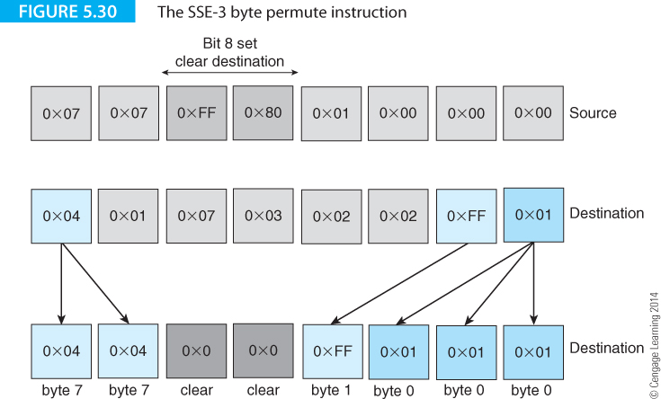
Computer Organization and Architecture: Themes and Variations, 1st Edition Clements
Figure 5.30 illustrates the PSHUFB mm,m64 instruction that takes a string of eight bytes in the destination register and re-orders them according to the contents of the corresponding byte in the source register.

Slide 71
Computer Organization and Architecture: Themes and Variations, 1st Edition Clements
A source byte defines where each byte of the destination is to come from in the source.
This arrangement allows you to both permute bytes and to repeat them; for example, the sequence 0x12345678 could be rearranged as 0x12785612 using permutation and repetition.
If a byte in the source has its most-significant bit set (0xFF and 0x80 in Figure 5.30) then the corresponding byte in the destination is cleared.

Slide 72
Computer Organization and Architecture: Themes and Variations, 1st Edition Clements
ARM Family Multimedia Instructions
Members of the ARM family have also implemented instruction extensions. The Cortex-A ARM processor has an advanced SIMD architecture extension, called NEON.
NEON technology operates with 64- and 128-bit data registers and can perform MP3 operations on processors operating at 10 MHz (a clock rate far lower than conventional PC processors).
ARM family SIMD extensions, also called DSP extensions, allow low-cost, low-speed processors to have cutting-edge architectures that permit the mass manufacture of very low-cost consumer entertainment and automotive systems.

Slide 73
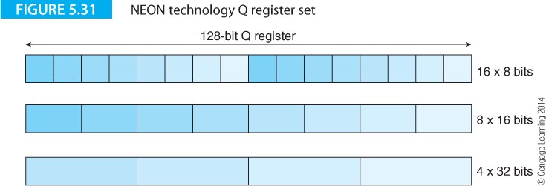
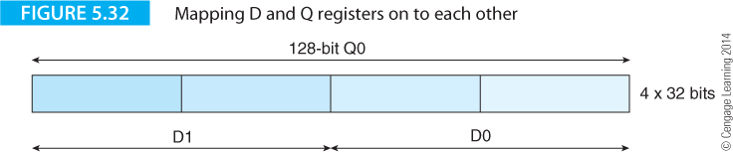
Computer Organization and Architecture: Themes and Variations, 1st Edition Clements
ARM Family Multimedia Instructions
The NEON architecture has two logical banks of registers; 64-bit D registers and 128-bit Q registers.

Slide 74
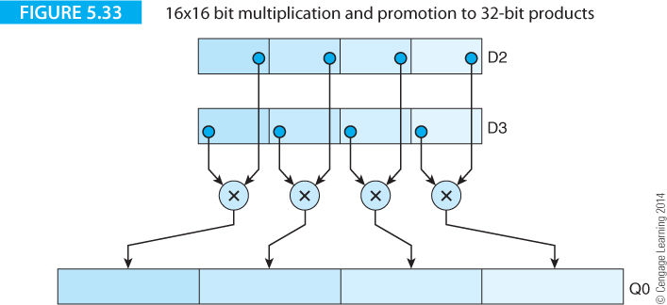
Computer Organization and Architecture: Themes and Variations, 1st Edition Clements
A typical operation is VADD.I16 D0,D1,D2 that adds four pairs of 16-bit values in registers D1 and D2 and puts the four 16-bit results in D0.
Consider the mixed 16-bit/32-bit multiplication operation VMUL.I32.S16 Q0,D2,D3 that forms the product of four pairs of 16-bit integers and returns the four 32-bit products in the 128-bit register Q0 (which is, of course, registers D1 and D0). Figure 5.33 demonstrates this operation.

