Slide 1
Chapter 8
Computer Organization and Architecture: Themes and Variations, 1st Edition Clements
Computer Organization and Architecture

Slide 2
Computer Organization and Architecture: Themes and Variations, 1st Edition Clements
Beyond RISC: Superscalar, VLIW, and Itanium

Slide 3
Computer Organization and Architecture: Themes and Variations, 1st Edition Clements
We now look at how computer performance has been pushed beyond the limit of one instruction per cycle set by pipelining, and introduce superscalar processing that uses multiple ALUs to enable instructions to be executed in parallel.
Superscalar computers are also referred to as post-RISC processors.
We introduce the very long instruction word, VLIW, processor that encodes multiple operations in a single instruction.
We provide an introduction to Intel’s IA64 architecture, Itanium, that combines several powerful architectural features to enhance its performance.

Slide 4
Computer Organization and Architecture: Themes and Variations, 1st Edition Clements
Parallel Execution
Superscalar processors rely on arranging instructions so that they can be executed simultaneously. Consider:
ADD r1,r2,r3
ADD r5,r4,r1 ;cannot be executed until r1 created
ADD r6,r5,r7 ;cannot be executed until r5 created
The above code cannot be executed in parallel because of data dependency. However, the following fragment can be executed in parallel.
ADD r1,r2,r3
ADD r4,r5,r6 ;no waiting for r5 and r6
ADD r7,r8,r9 ;no waiting for r8 and r9

Slide 5
Computer Organization and Architecture: Themes and Variations, 1st Edition Clements
Architecture, Organization, Performance, and Challenges
The instruction sets of today’s processors are remarkably similar to ISAs of the 1980s. However, their organization has changed dramatically. Changes in the way we implement processors has considerably increased performance.
A purist could maintain that organization and architecture are independent. However, a particular architecture may have a preferred organization. Pipelining is easier to implement in RISC than in CISC architectures, although Intel has successfully married CISC with pipelining.
Superscalar organization extends the performance gains of pipelining by using multiple execution units. Pipelining and superscalar technologies are orthogonal in the sense that they are independent of each other.
Superscalar organization creates new challenges for the systems designer, because of structural hazards – conflicts that occur when different instructions request the same resources. For example, if two additions are computed sequentially, the state of the zero flag can be tested separately after each addition. However, if the additions are performed in parallel, then what meaning is associated with testing the status flag?

Slide 6
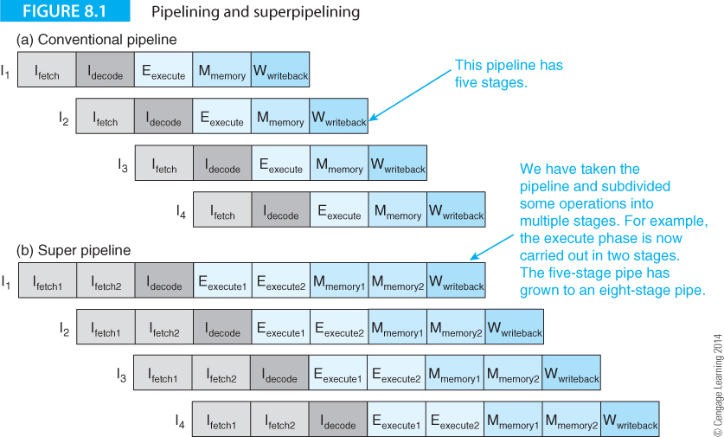
Computer Organization and Architecture: Themes and Variations, 1st Edition Clements
Superscalar Architecture
Let’s first look at how pipelining can be extended. Figure 8.1a illustrates pipelining where instruction execution is overlapped.

Slide 7
Computer Organization and Architecture: Themes and Variations, 1st Edition Clements
Superscalar Architecture
Figure 8.1b illustrates superpipelining where some stages are subdivided; for example, the fetch stage is split into I_{fetch1} and I_{fetch2}, whereas the decode stage remains a single operation.

Slide 8
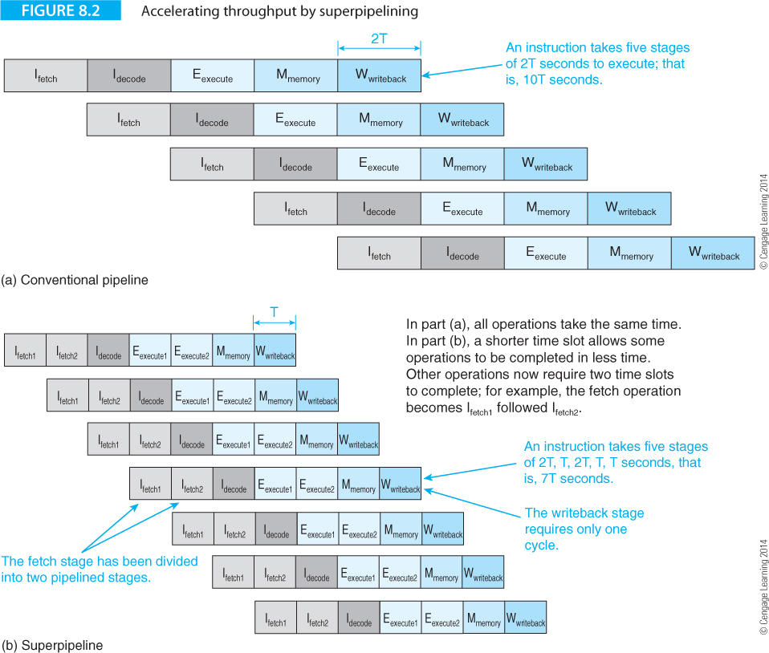
Computer Organization and Architecture: Themes and Variations, 1st Edition Clements
Figure 8.1 doesn’t tell you what is happening because it omits time. Figure 8.2 demonstrates the effect of superpipelining by allowing some operations to take place in half a clock cycle.

Slide 9
Computer Organization and Architecture: Themes and Variations, 1st Edition Clements
Superpipelining reduces the granularity of the processes in the pipeline by reducing the size of the smallest task that a stage can handle.
Average instruction throughput is increased at the cost of a higher clock rate.
However, the branch penalty is increased because of the larger number of stages that have to be flushed on a mispredicted branch.
At best, superepipelining offers only a modest increase in performance.
Moreover, increasing the number of pipelined states requires a greater interstage delay because the extra registers have their own setup and hold times.
A more radical approach to pipelining is required to break the one instruction per cycle barrier.

Slide 10
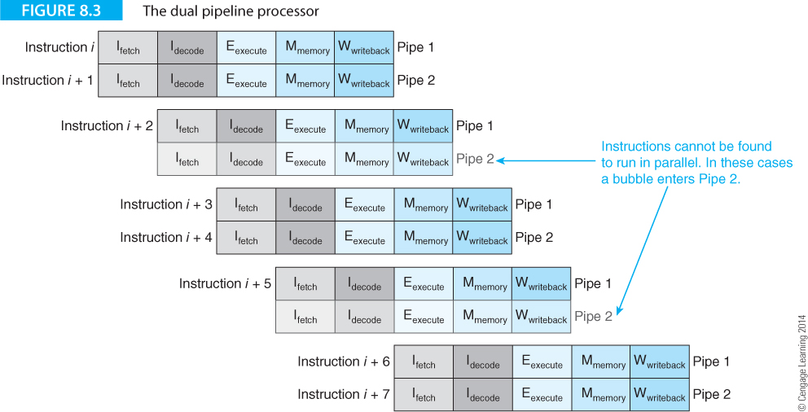
Computer Organization and Architecture: Themes and Variations, 1st Edition Clements
The only way that to increase throughput beyond the one cycle per instruction barrier is to employ multiple execution units.
Figure 8.3 illustrates a processor with two parallel five-stage pipelines that can double the throughput without increasing the clock rate. Both pipelines are not always used; sometimes it’s impossible to find two instructions to execute in parallel.

Slide 11
Computer Organization and Architecture: Themes and Variations, 1st Edition Clements
An arrangement with m parallel pipelines is called an m-way superscalar processor.
However, you cannot expect an m-fold increase in performance.
In practice, it’s even harder to approach the m instructions per cycle ideal for an m-way superscalar processor than it is to approach the one instruction per cycle goal for a pipelined processor.
The Pentium P5, introduced in 1993, had two integer pipelines but its second pipeline could be used for only about 30% of the time.
The original Pentium introduced in 1993 with a speed of 60 or 66 MHz had two 5-stage integer pipelines U and V and a six-stage floating-point unit.
The U and V pipelines were not identical because the U pipe included a shifter.

Slide 12
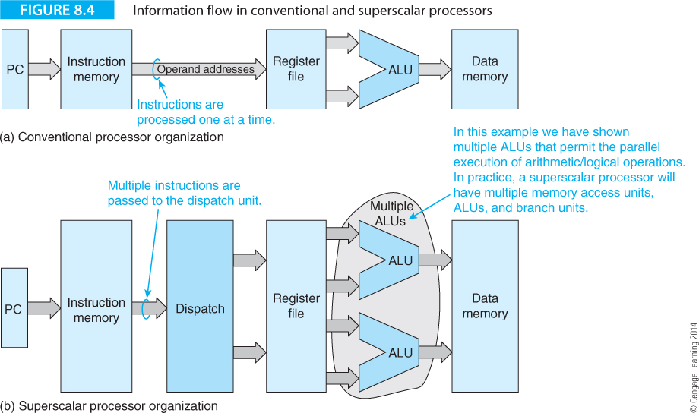
Computer Organization and Architecture: Themes and Variations, 1st Edition Clements
Superscalar processors are not implemented by taking a RISC and increasing the number of pipelines.
They are implemented by adding resources such as multiple processing units to allow parallel instruction overlap. Figure 8.4(a) illustrates the information flow in a conventional pipelined processor and Figure 8.4(b) shows the information flow in a generic superscalar processor with two ALUs.

Slide 13
Computer Organization and Architecture: Themes and Variations, 1st Edition Clements
The superscalar processor takes multiple instructions from the instruction source and then dispatches them in parallel to a multiported register file, where the operands are looked up and transmitted to multiple ALUs.
This is a simplistic picture because it omits a key consideration; the way in which instructions are dispatched in parallel.
Instructions come from several sources, such as the cache memory and local instruction buffers, and have to be executed in the correct semantic order.
The expression correct semantic order indicates that the order of instruction execution must not change the meaning of the program and end result.
In an out-of-order processor the actual order of instruction execution can be changed from the program order as long as the meaning of the program remains unaltered. Consider :
Case 1 Case 2
ADD r1,r2,r3 ADD r1,r2,r3
ADD r4,r1,r3 ADD r5,r6,r7
ADD r5,r6,r7 ADD r4,r1,r3

Slide 14
Computer Organization and Architecture: Themes and Variations, 1st Edition Clements
Case 1 Case 2
ADD r1,r2,r3 ADD r1,r2,r3
ADD r4,r1,r3 ADD r5,r6,r7
ADD r5,r6,r7 ADD r4,r1,r3
Suppose the instruction sequence in Case 1 is the original program sequence. In Case 2 we have re-ordered this sequence.
The semantic meaning has not been changed; that is, executing the code of Case 1 and Case 2 will yield the same result.
The object of a superscalar processor is to allow code to be executed in parallel without changing the semantic order.

Slide 15
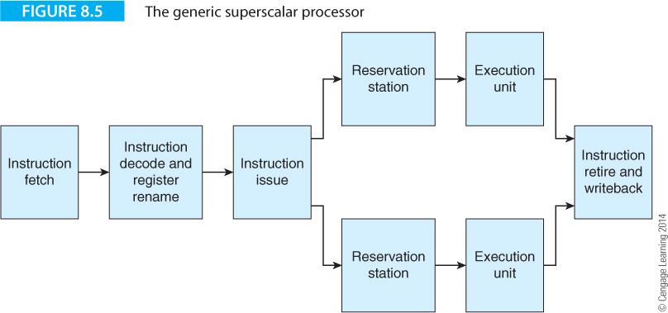
Computer Organization and Architecture: Themes and Variations, 1st Edition Clements
Figure 8.5 provides a more realistic structure of a superscalar processor that consists of five elements.

Slide 16
Computer Organization and Architecture: Themes and Variations, 1st Edition Clements
Instruction fetch
The instruction fetch stage obtains the instructions from memory, the cache or any other mechanism used to hold instructions to be executed.
Instruction decode
The instruction decode and register rename stage decodes the instructions and renames any resources required by the instructions.
Register renaming reduces the effect of bottlenecks caused by the limited number of user-visible registers by using temporary registers.
Instruction issue
The instruction issue stage forwards instructions to the execution units and ensures that the maximum number of instructions possible is executed in parallel. The two terms issue and dispatch describe the forwarding of instructions for execution. Dispatch indicates that an instruction is transmitted to functional units for execution, and issue indicates that an instruction is transmitted to an execution unit even though that instruction may not yet be ready for immediate execution.

Slide 17
Computer Organization and Architecture: Themes and Variations, 1st Edition Clements
Reservation stations
The reservation stations and execution units are the instruction buffers and ALUs (or other functional devices) that interpret the stream of op-codes.
The reservation stations dispatch instructions to the associated processing units only when all the required resources are available.
Instruction retire
The instruction retire and writeback stage is responsible for writing back the result to registers and ensuring that instructions are completed in the correct order.
This stage also communicates with the reservation stages when instruction completion frees resources.

Slide 18
Computer Organization and Architecture: Themes and Variations, 1st Edition Clements
When instructions are executed strictly sequentially in program order they are said to be processed in-order.
If instructions are not executed in program sequence with one instruction being executed before the previous instruction, they are said to be processed out-of-order.
Parts of a superscalar pipeline may operate in-order and other parts operate out-of-order.
Note that out-of-order execution is not a characteristic of superscalar processing but a technique that can be exploited to enhance superscalar processing; that is, out-of-order execution is not a fundamental requirement of superscalar processing; it is a necessary evil.

Slide 19
Computer Organization and Architecture: Themes and Variations, 1st Edition Clements
In Figure 8.5 the instruction retire stage is responsible for ensuring that instructions are completed in order whether or not they were executed out-of-order. Consider the following example that demonstrates the concept of in order and out-of-order execution:
Instruction Case 1 Case 2 Case 3
1 ADD R1,R2,R3 ADD R1,R2,R3 ADD R1,R2,R3
2 ADD R4,R1,R7 ADD R6,R3,R8 ADD R8,R6,R2
3 ADD R5,R1,R2 ADD R4,R1,R7 ADD R4,R1,R7
4 ADD R6,R3,R8 ADD R5,R1,R2 ADD R5,R1,R2
ADD R8,R6,R2 ADD R8,R6,R2 ADD R6,R3,R8
Case 1 demonstrates a sequence of instructions that could generate hazards (data dependencies) when executed in a pipelined computer because of the two read before write hazards; that is, R1 in instruction 2 and R5 in instruction 5.

Slide 20
Computer Organization and Architecture: Themes and Variations, 1st Edition Clements
Instruction Case 1 Case 2 Case 3
1 ADD R1,R2,R3 ADD R1,R2,R3 ADD R1,R2,R3
2 ADD R4,R1,R7 ADD R6,R3,R8 ADD R8,R6,R2
3 ADD R5,R1,R2 ADD R4,R1,R7 ADD R4,R1,R7
4 ADD R6,R3,R8 ADD R5,R1,R2 ADD R5,R1,R2
ADD R8,R6,R2 ADD R8,R6,R2 ADD R6,R3,R8
Case 2 demonstrates the effect of introducing out-of-order execution by reordering the instruction stream to remove these dependencies. In this case the semantics of the code is unaltered.
In case 3, out-of-order execution has also been applied to remove the dependencies. However, the semantics of the code is changed because R6 is used in instruction 2 but is not created until instruction 5.
This demonstrates that out-of-order execution is possible, but only with care.

Slide 21
Computer Organization and Architecture: Themes and Variations, 1st Edition Clements
Let’s look at an example that illustrates superscalar execution by demonstrating the effect of both in-order and out-of-order execution. Consider the following code fragment.
The comments in the rightmost column indicate the restrictions placed on the execution of the corresponding instruction; for example, the load requires two cycles, and there is only one multiplier (a resource dependency) which prevents parallel multiplications.
I1 x = b* LDR X,[B] a load takes two cycles
I2 b = b + 1 ADD B,B,#4
I3 y = c.g MUL Y,C,G only one multiplication at a time
I4 d = c.x MUL D,C,X multiply (only one at a time)
I5 f = d – q SUB F,D,Q RAW data dependency with I4
I6 e = p + g ADD E,P,G
I7 x = a.f MUL X,A,F multiply (only one at a time)
I8 c = c + 1 ADD C,C,#1
I9 e = e + 1 ADD E,E,#1

Slide 22
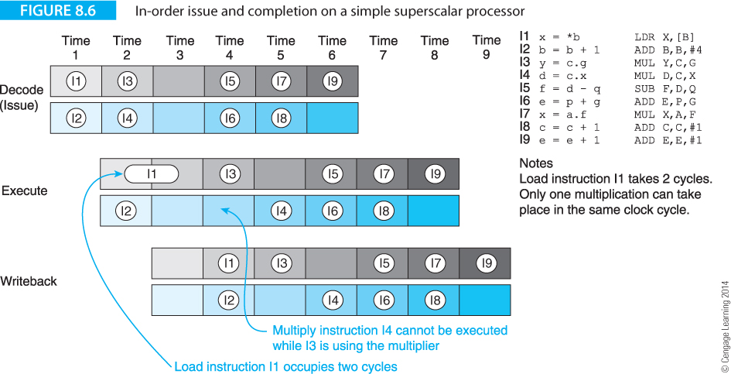
Computer Organization and Architecture: Themes and Variations, 1st Edition Clements
Figure 8.6 illustrates a superscalar model where instructions are issued and executed in-order in a simple two-way superscalar machine. This machine has only three stages: decode/issue, execute, and write-back (store operand). A non-superscalar RISC processor with a three-stage pipeline would take four cycles to complete the first instruction (the load), and 12 cycles to execute all the instructions. (Twelve cycles are required because of the 3 cycle latency, 8 successive cycles and the 1-cycle stall caused by I1.)

Slide 23
Computer Organization and Architecture: Themes and Variations, 1st Edition Clements
Figure 8.6 demonstrates that the superscalar achieves a reduction of only three cycles over a single 3-stage pipeline. Initially, instructions I1 and I2 are issued in parallel. However, because I1 has a two-cycle latency, I2 can be executed but cannot be retired (written-back) in the next cycle until I1 has been completed. If I2 were permitted to write its results before I1 had finished, and an interrupt were taken, the architectural state in registers and memory would be in error. Instructions I1 and I2 are retired in time slot 4.

Slide 24
Computer Organization and Architecture: Themes and Variations, 1st Edition Clements
The hardware dependencies between multiplication instructions I3 and I4 ensures that only one pipe can be used in time slots t4 and t5; that is, superscalar processing cannot be exploited. Moreover, the RAW hazard between instructions I4 and I5 ensures that I4 must be executed before I5. Although we have implemented superscalar processing, we have achieved a speedup of 12/9 = 1.3, rather than the desired 2 that could have been achieved if both execution units had been fully used.

Slide 25
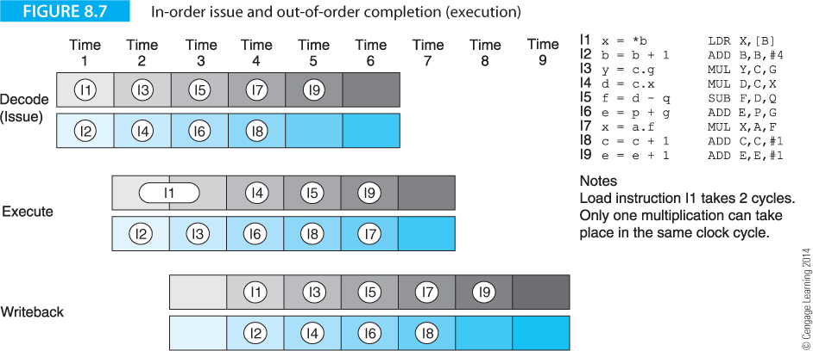
Computer Organization and Architecture: Themes and Variations, 1st Edition Clements
Let’s now modify the processor to permit a degree of out-of-order processing. Figure 8.7 illustrates in-order issue and out-of-order completion.
In this case I2 is completed before I1, and the number of cycles reduced by one. Instructions I1 to I9 are executed in 8 cycles with out-of-order processing. An instruction can complete out of order, but is never retired out of order, since retiring involves updating the state of the machine.

Slide 26
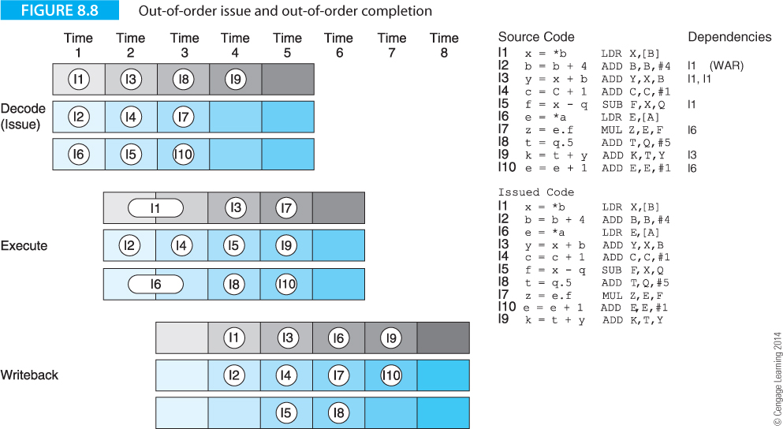
Computer Organization and Architecture: Themes and Variations, 1st Edition Clements
Figure 8.8 extends this example by permitting out-of-order issue and out-of-order completion. We have used a three-way superscalar model with different code and have included two loads and a multiplication. In Figure 8.8 we have given the issued code below the original code. Note that the writeback (retire) stage ensures that instructions are retired in order.

Slide 27
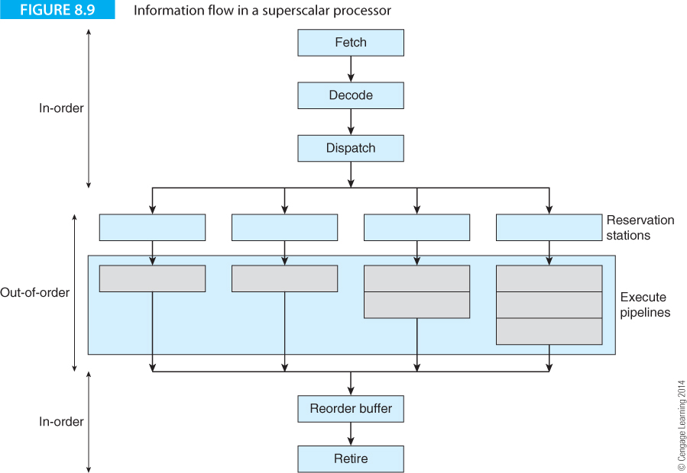
Computer Organization and Architecture: Themes and Variations, 1st Edition Clements
Figure 8.9 illustrates information flow in a conceptual out-of-order superscalar processor. The front end resembles a RISC processor and ensures a continuous flow of instructions. The middle part consists of the reservation stations and the pipelined execution units, where some pipelines have one stage such as integer operations and others have multiple stages such as floating-point operations. This middle stage operates in an out-of-order fashion. The end stage consists of the reorder buffer and the retire (i.e., writeback) stage, where instructions are completed in order.

Slide 28
Computer Organization and Architecture: Themes and Variations, 1st Edition Clements
The strength of a superscalar processor is that it is able to execute an arbitrary number of instructions in parallel.
The weakness is that those instructions have to be fetched from memory, which requires a corresponding increase in the performance (i.e., transfer bandwidth) of the upstream stages and the processor hardware has to identify which instructions can be executed in parallel without changing a program’s semantics.
Moreover, it has to manage resources by optimally allocating them to instructions.
All these operations can perhaps be better performed by the compiler.
In the next section, we look more closely at the nature of instruction level parallelism and demonstrate how renaming registers at run time can improve performance.

Slide 29
Computer Organization and Architecture: Themes and Variations, 1st Edition Clements
Instruction Level Parallelism (ILP)
We now take a fragment of code and examine how the use of instruction level parallelism can improve throughput.
To keep things simple, we consider only a processor that can execute two instructions at the same time.
Consider a fragment of code that performs the vector addition C = A + B.
for (i = 0; i < n; i++) {
c[i] = a[i] + b[i];
}

Slide 30
Computer Organization and Architecture: Themes and Variations, 1st Edition Clements
We can translate this algorithm into generic load/store architecture code as follows:
Start ldr r1,a ;put base address of array A in pointer r1
ldr r2,b ;put base address of array B in pointer r2
ldr r3,c ;put base address of array C in pointer r3
ldr r4,n ;load the loop count for n cycles in r4
Loop ldr r5,[r1] ;REPEAT get a[i]
ldr r6,[r2] ; get b[i]
stall ; wait for r6 to load from array B
add r5,r5,r6 ; c[i] = a[i] + b[i]
str r5,[r3] ; store c[i]
add r1,r1,#4 ; increment pointer to a[i]
add r2,r2,#4 ; increment pointer to b[i]
add r3,r3,#4 ; increment pointer to c[i]
sub.s r4,r4,#1 ; decrement loop counter
bne Loop ;until loop completed

Slide 31
Computer Organization and Architecture: Themes and Variations, 1st Edition Clements
This code employs three array pointers that are explicitly updated at the end of each iteration.
Instructions take one cycle except for the load r6 that takes two cycles when a stall cycle is introduced forcing the next operation to wait for the data to be retrieved.
A superscalar processor with two processing units could execute the main loop in the following way.
In order to simplify the problem, we have assumed that the two processing units can carry out all operations.
In practice, this may not be the case and it will be necessary to schedule the code to make optimum use of the available resources.

Slide 32
Computer Organization and Architecture: Themes and Variations, 1st Edition Clements
Processing unit 1 Processing unit 2
Loop ldr r5,[r1] ;REPEAT get a[i]
ldr r6,[r2] ;get b[i]
stall
add r5,r5,r6 add r1,r1,#4 ;calculate c[i]; update a ptr
str r5,[r3] add r2,r2,#4 ;store c[i]; update b ptr
sub.s r4,r4,#1 add r3,r3,#4 ;dec loop ctr; update c ptr
bne.s Loop ;until loop completed
By reordering the code, the number of cycles has been reduced to 5 per iteration.
Clearly, the generation of the code has a significant effect on the level of the parallelism that can be exploited.

Slide 33
Computer Organization and Architecture: Themes and Variations, 1st Edition Clements
Processing unit 1 Processing unit 2
Loop ldr r5,[r1] add r1,r1,#4
ldr r6,[r2] add r2,r2,#4
ldr r5a,[r1a] add r1a,r1a,#4
ldr r6a,[r2a] add r2a,r2a,#4
add r5,r5,r6 sub.s r4,r4,#1
str r5,[r3] add r5a,r5a,r6a
str r5a,[r3a] add r3a,r3a,#4
add r3,r3,#4 bne Loop
We can exploit superscalar processing further by loop unrolling. Here, two iterations are executed per loop.
To make the code more readable we use the notation that register r5 contains a[i] and register r5a contains a[i+1]. We perform two iterations in 8 cycles, corresponding to one iteration in 4 cycles.

Slide 34
Computer Organization and Architecture: Themes and Variations, 1st Edition Clements
Data Dependencies and Register Renaming
Data dependency is a crucial factor in instruction level parallelism, as all too frequently an instruction cannot be executed because an operand is not currently available.
One approach to reducing data dependency involves a mechanism called register renaming (i.e., the use of virtual registers) which dates back to the late 1960s when it was used by IBM.
Some data dependencies can be removed by the allocation of extra registers at run time.
Register renaming is a means of creating apparently new registers by reassigning the names of physical registers.

Slide 35
Computer Organization and Architecture: Themes and Variations, 1st Edition Clements
Consider an example that calculates:
a = b + c;
p = q + r;
1 ldr r1,[r2] ;get b from memory
2 add r3,r1,r4 ;add c to b from register r4 to get a
3 ldr r1,[r5] ;get q from memory
4 add r6,r1,r7 ;add r to q from register r7 to get p
One approach to reducing data dependency involves a mechanism called register renaming (i.e., the use of virtual registers) which dates back to the late 1960s when it was used by IBM.
Some data dependencies can be removed by the allocation of extra registers at run time.
Register renaming is a means of creating apparently new registers by reassigning the names of physical registers.

Slide 36
Computer Organization and Architecture: Themes and Variations, 1st Edition Clements
a = b + c;
p = q + r;
1 ldr r1,[r2] ;get b from memory
2 add r3,r1,r4 ;add c to b from register r4 to get a
3 ldr r1,[r5] ;get q from memory
4 add r6,r1,r7 ;add r to q from register r7 to get p
Consider the history of r1.
It is loaded with an operand in line 1 and that operand is used in line 2.
The instruction in line 3 reuses register r1 in the calculation of p because its contents are no longer needed after of a has been calculated in line 2.
However, pipelined and superscalar processors run into a problem because the first use and the subsequent reuse of register r1 may overlap.

Slide 37
Computer Organization and Architecture: Themes and Variations, 1st Edition Clements
Consider the following example on a generic machine. This code loads data and evaluates a simple expression.
1 ldr r1,[r0] ;get x
2 ldr r2,[r3] ;get y in r2 (first use of r2)
3 mlt r4,r1,r2 ;z = x·y
4 sub r5,r1,#4 ;q = x - 4
5 div r2,r1,r5 ;z = x/(x – y) (reuse of r2)
add r6,r4,r2 ;s = x·y + x/(x – 4)

Slide 38
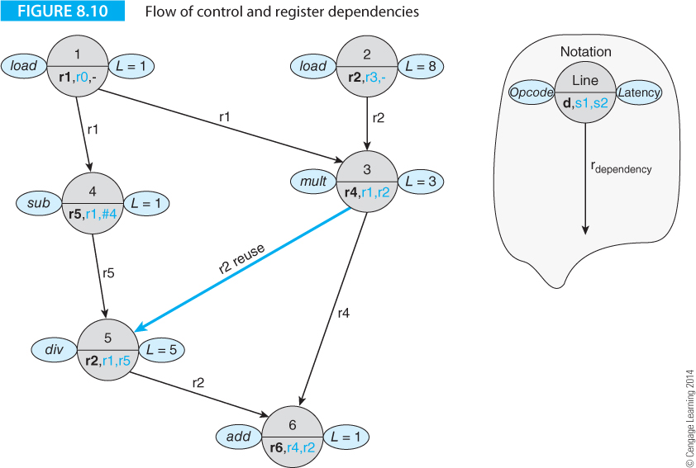
Computer Organization and Architecture: Themes and Variations, 1st Edition Clements
Figure 8.10 illustrates this sequence of instructions being executed. We have used a notation that gives the program line number of each instruction, the operation being performed, the latency of the instruction, the destination operand, and the source operands. Lines drawn between instructions indicate dependencies; for example, instruction 3 uses registers r1 and r2 from instructions 1 and 2, respectively.

Slide 39
Computer Organization and Architecture: Themes and Variations, 1st Edition Clements

Slide 40
Computer Organization and Architecture: Themes and Variations, 1st Edition Clements
Figure 8.10 demonstrates the effect of the false data dependency and the reuse of register r2 in instruction 5 by the heavy blue line. As you can see, the execution process along the path 1, 4, 5, 6 is held up by the path 2, 3, 6. False data dependency indicates that the dependency is not inherent but is caused by a WAW (write-after-write) or WAR (write-after-read) operation.

Slide 41
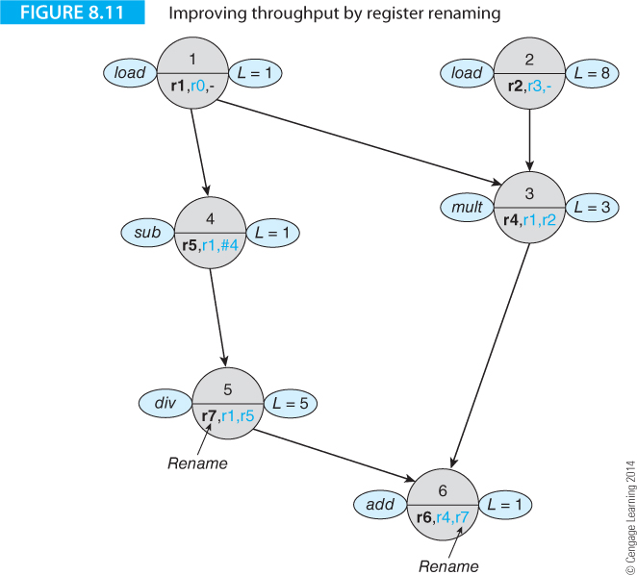
Computer Organization and Architecture: Themes and Variations, 1st Edition Clements
By renaming register r2 as register r7 in instructions 5 and 6, the delay imposed on instruction 5 is removed. The arrangement of Figure 8.11 permits a significant improvement by means of out-of-order execution and register renaming. The execution of instructions 1, 4, and 5 can take place in parallel with the execution of instructions 2 and 3.

Slide 42
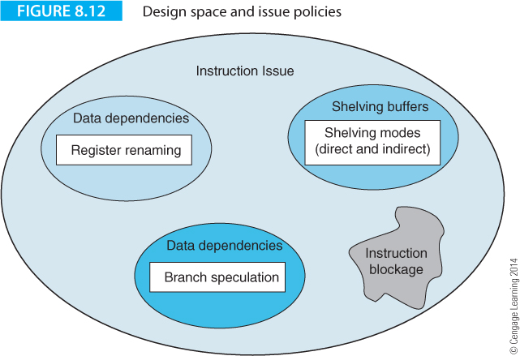
Computer Organization and Architecture: Themes and Variations, 1st Edition Clements
Superscalar Instruction Issue
Sima, Fountain and Kacsuk, employ the term design space to indicate the range of solutions that are available to the designer. Figure 8.12 illustrates the design space for instruction issue policies.

Slide 43
Computer Organization and Architecture: Themes and Variations, 1st Edition Clements
Data Dependencies
True data dependencies cannot be eliminated by hardware or software techniques. In the code below, the ADD instruction cannot be executed until after the load has taken place.
LDR r3,[r10] ;get data into r3
ADD r5,r3,r4 ;now add the value in r3 to r4
Two false data dependencies can be removed by hardware or software techniques. An output dependency occurs when two instructions write to the same location; for example
ADD r3,r1,r2 ;add r1 and r2
SUB r5,r6,r4 ;subtract r4 from r6 and put the result in r5
ADD r3,r7,r8 ;now reuse r3 in the next calculation
Register r3 is the destination for an operand in the first line and this operand is used in the second line .Register r3 is re-used as a destination operand in the third instruction. If the write to r3 caused by ADD r3,r7,r8 occurs before the read in SUB r5,r3,r4, an error will occur.
The antidependency is a write-after-read hazard (WAR that occurs when an instruction uses a location as a source and a following instruction reuses the location as a destination; for example,
ADD r3,r1,r2 ;add r1 and r2
ADD r1 r5,r4 ;reuse r1 to hold the sum of r53 and r4
When the first instruction is executed, r1 is read. The next instruction reuses r1 as a destination register. If the write to r1 in the second instruction takes place before the read in the first instruction, an error will occur.

Slide 44
Computer Organization and Architecture: Themes and Variations, 1st Edition Clements
Control Dependencies
Superscalar processors are even more susceptible to the effects of control dependencies than scalar pipelines.
Taking a branch not only requires you to flush one pipeline, it requires you to flush multiple pipelines.
Superscalar systems have only two options. They can detect control dependency and block further instruction issue until the control dependency has been resolved, or they can speculatively execute instructions along the predicted branch path.
Figure 8.12 calls the third component of issue policy design space shelving, a means of holding instructions in a special buffer until all their resources become available.
If you don’t implement shelving, you have to use direct issue whereby instructions are forwarded directly to the appropriate functional or execution units.

Slide 45
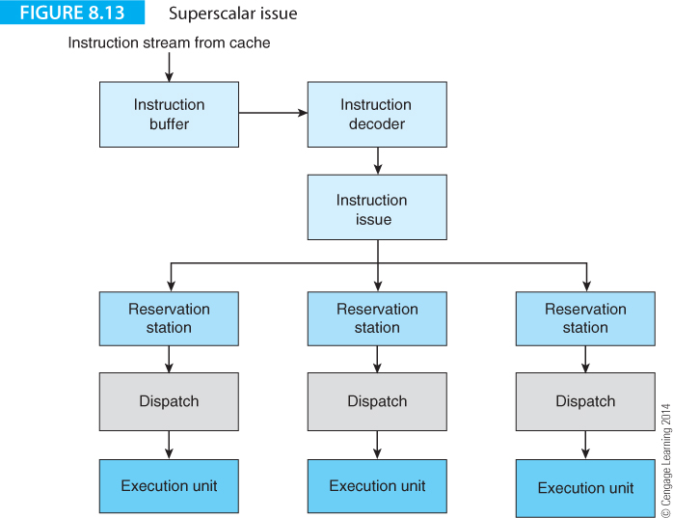
Computer Organization and Architecture: Themes and Variations, 1st Edition Clements
Figure 8.13 illustrates the shelving buffers or reservation stations in the chain from the instruction cache to the execution units. Instructions from the instruction buffer are decoded and transmitted to the instruction issue stage. The group of instructions being processed by the issue mechanism is referred to as an issue window. This is the group of instructions over which dependencies are checked in order to determine whether instructions can be executed in parallel.

Slide 46
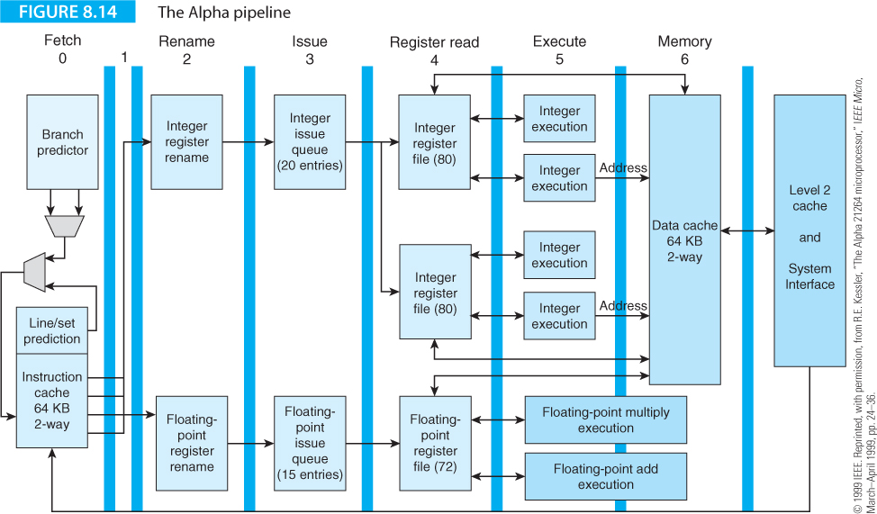
Computer Organization and Architecture: Themes and Variations, 1st Edition Clements
Examples of Superscalar Processors

Slide 47
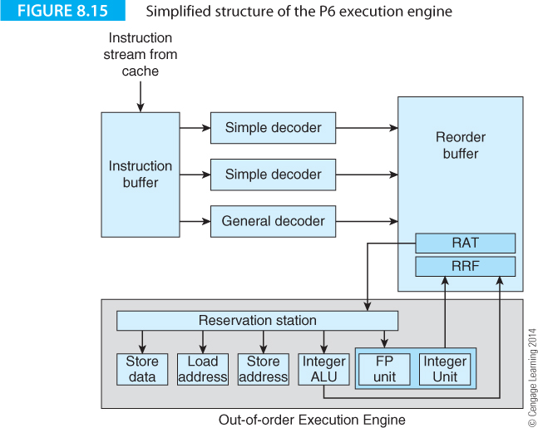
Computer Organization and Architecture: Themes and Variations, 1st Edition Clements

Slide 48
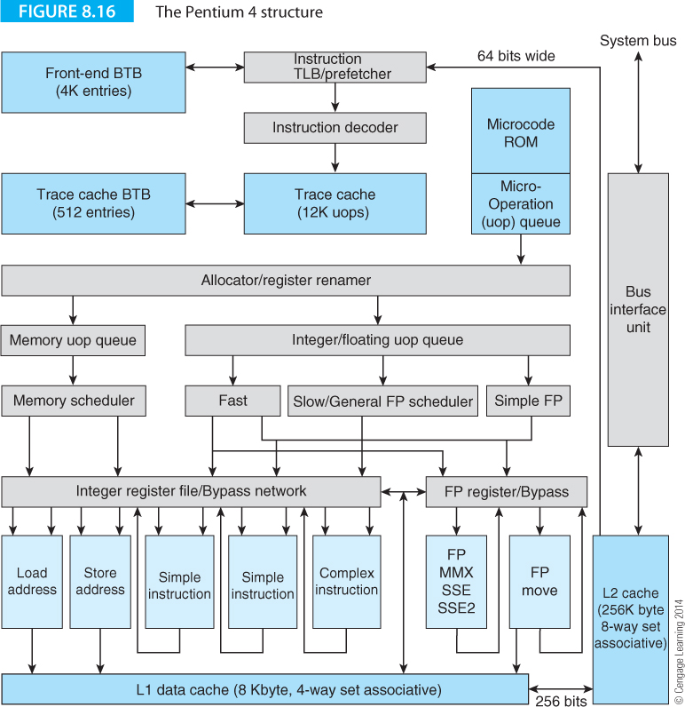
Computer Organization and Architecture: Themes and Variations, 1st Edition Clements

Slide 49
Computer Organization and Architecture: Themes and Variations, 1st Edition Clements
VLIW Processors
The VLIW or very long instruction word processor uses a long instruction word to specify a fixed number of operations that are to be executed in parallel
A VLIW processor allows the programmer or compiler to specify multiple instructions that are to be executed concurrently.
The instruction word is long (i.e., wide) simply because it is made up of several individual instructions; for example, you could construct a 96-bit VLIW processor that is able to execute three 32-bit MIPs instructions concurrently.
Some use the term molecule or bundle to describe the VLIW instruction that consists of several operations called atoms or syllables, respectively.

Slide 50
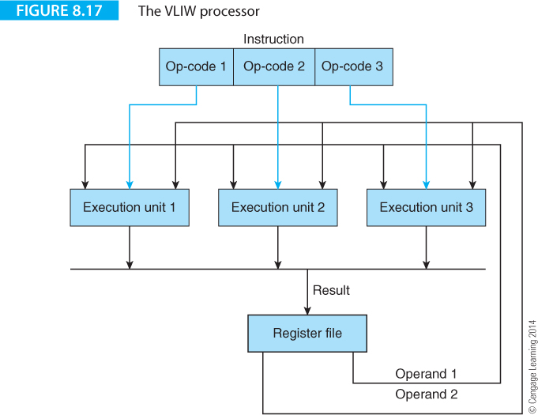
Computer Organization and Architecture: Themes and Variations, 1st Edition Clements

Slide 51
Computer Organization and Architecture: Themes and Variations, 1st Edition Clements
To compare the notions of superscalar with VLIW means comparing organization with architecture.
However, there are important differences between these two paradigms.
VLIW processors identify parallelism at compile time, because the instructions generated by a compiler are suitable for parallel execution and no dependencies have been detected; that is, the compiler has the time and resources to optimally arrange instructions to exploit the most parallelism.
A superscalar processor has to dynamically issue multiple instructions and deal with the problems of control and resource dependencies dynamically in the processor’s hardware at run time.

Slide 52
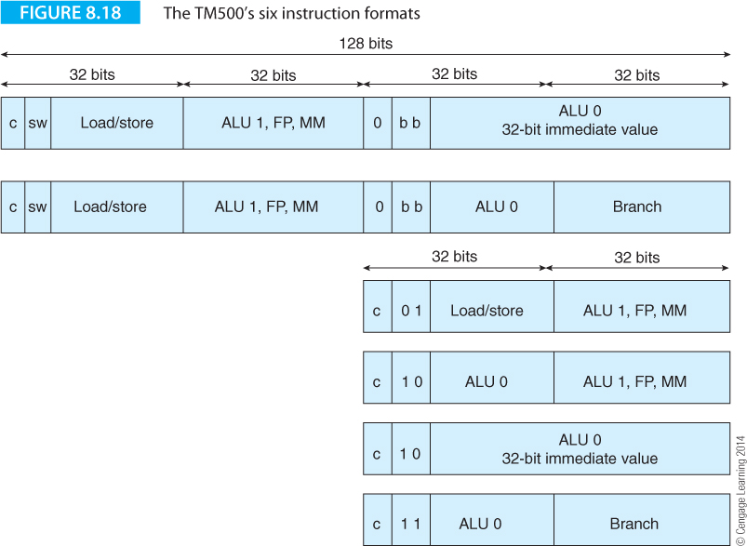
Computer Organization and Architecture: Themes and Variations, 1st Edition Clements
Crusoe – a Failed VLIW Processor
Transmeta created a VLIW processor to emulate the IA32 architecture by means of code morphing. The Crusoe uses a 128-bit word, called a molecule, that is divided into four 32-bit atoms. The expressions molecule and atom are Transmeta’s own terms.
Figure 8.18 illustrates the Crusoe’s six instruction formats. Two formats are 128-bit bundles and two are 64-bit bundles.

Slide 53
Computer Organization and Architecture: Themes and Variations, 1st Edition Clements
Typically, VLIW instruction formats are limited by restrictions on the operations that may be assigned to the three slots. For example, the first two slots might be reserved for integer operations, whereas the third slot may hold only a floating-point operation. Such an arrangement would mean that the sequence
ADD r1,r2,r3
ADD r4,r5,r6
SUBF r7,r8,r9 ;floating point subtraction
could be fitted in one instruction,
ADD r1,r2,r3: ADD r4,r5,r6: SUBF r7,r8,r9

Slide 54
Computer Organization and Architecture: Themes and Variations, 1st Edition Clements
whereas the sequence
ADD r1,r2,r3
ADDF r4,r5,r6
SUBF r7,r8,r9 ;floating point subtraction
would require the two instructions
ADD r1,r2,r3
NOP ;the second integer slot
ADDF r4,r5,r6
NOP ;the first integer slot
NOP ;the second integer slot
SUBF r7,r8,r9
That can be represented as:
ADD r1,r2,r3: NOP: ADDF r4,r5,r6; first long instruction
NOP: NOP: SUBF r7,r8,r9; second long instruction

Slide 55
Computer Organization and Architecture: Themes and Variations, 1st Edition Clements
Two formats are 128-bit bundles and two are 64-bit bundles. By providing both 128-bit and 64-bit bundles, Transmeta ensures that no bundle will have to introduce two NOPs when the compiler can’t find four instructions to execute in parallel.
Ultimately, Crusoe was a commercial failure because it failed to deliver the necessary performance.

Slide 56
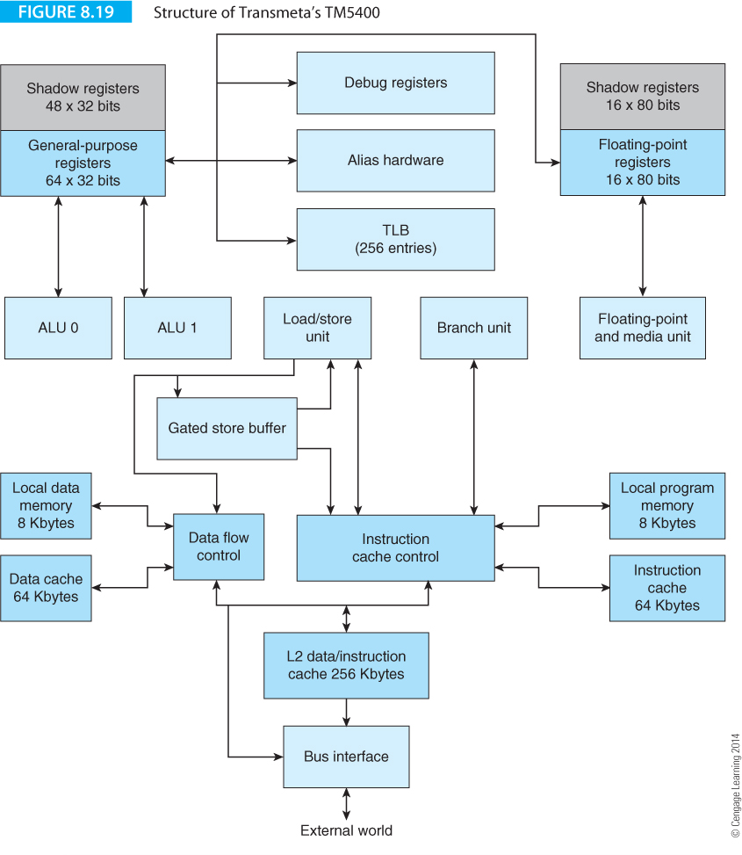
Computer Organization and Architecture: Themes and Variations, 1st Edition Clements

Slide 57
Computer Organization and Architecture: Themes and Variations, 1st Edition Clements
The IA64 Itanium architecture
We now introduce the IA64 or Itanium architecture, Intel’s big brother to the IA-32 architecture that encompasses the 80386, 80486 Pentium, and iCore families.
Successor to the IA-32 it may well be, but heir it ain’t.
The introduction of the Itanium processor in 2001 represented one of the most significant developments in microprocessor architecture in a decade.

Slide 58
Computer Organization and Architecture: Themes and Variations, 1st Edition Clements
Itanium is aimed at the high-performance workstation market. The first version of the Itanium in 2001 proved somewhat disappointing.
A second version of the Itanium, codenamed McKinley, was launched in 2002 to better compete with other manufacturers in the RISC workstation market.
The McKinley version of Itanium 2 was constructed with 0.18 micron technology. In 2003 Intel launched a second version of the Itanium 2, the Madison, constructed with 0.13 micron technology and a massive 6 MB on-chip cache. By 2006 a dual-core Itanium was available.
In 2010 Intel announced its Itanium 9300 series that included multicore technology plus an enhanced memory interface. In spite of the Itanium’s pedigree, it has not yet grabbed a large share of the market for workstations.
In February 2010 Intel announced that 80% of the Global 100 corporations had chosen Itanium-based servers for their most mission-critical applications. In 2011 Intel announced an 8 core version of the IA64.

Slide 59
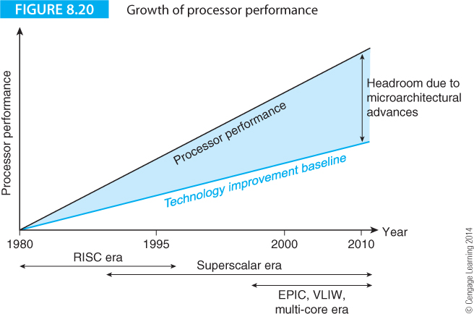
Computer Organization and Architecture: Themes and Variations, 1st Edition Clements
Performance Increase
Figure 8.20 shows the progression of computing performance over two decades as a function of improvements in semiconductor technology and in architecture and organization.
The trace at the bottom demonstrates the expected increase in performance if RISC technology alone had become standard and no future changes made other than by improving manufacturing techniques.

Slide 60
Computer Organization and Architecture: Themes and Variations, 1st Edition Clements
Figure 8.21 describes the format of an IA64 instruction, or, to be more precise, a bundle of three 41-bit instructions.
Each of these instructions has an op-code, three register fields and a predicate field that is used to implement predicated execution, rather like ARM.
As well as the three instructions, there’s a 5-bit template that tells the processor something about the structure of the three following op-codes.

Slide 61
Computer Organization and Architecture: Themes and Variations, 1st Edition Clements
A feature peculiar to the Itanium VLIW is the use of a symbol to indicate the extent of a region of parallelism.
The Itanium uses two semicolons to indicate a stop between regions of parallelism, and the braces “{” and “}” enclose instruction bundles. We will cover stops and bundles later. A simple example of a stop is:
add r1 = r2,r3 //r1 = r2 + r3
add r4 = r6,r7 ;; //r4 = r6 + r7 We need a stop because of the RAW
// hazard in the next instruction
add r5 = r4,r1 //r4 = r6 + r7

Slide 62
Computer Organization and Architecture: Themes and Variations, 1st Edition Clements
A feature peculiar to the Itanium VLIW is the use of a symbol to indicate the extent of a region of parallelism.
The Itanium uses two semicolons to indicate a stop between regions of parallelism, and the braces “{” and “}” enclose instruction bundles. We will cover stops and bundles later. A simple example of a stop is:
add r1 = r2,r3 //r1 = r2 + r3
add r4 = r6,r7 ;; //r4 = r6 + r7 We need a stop because of the RAW
// hazard in the next instruction
add r5 = r4,r1 //r4 = r6 + r7
The stop ensures that all instructions are completed prior to proceeding.

Slide 63
Computer Organization and Architecture: Themes and Variations, 1st Edition Clements
A fragment of IA64 code looks like this:
{
cmp.ne p1 = rx,ry // Perform the comparison x == y with result in p1
(p1) br else // If true then do the else part
}
{.label then
add rp = rz, 1 // z++
add rp = rp, rq // p += q
br exit // jump over else part
}
{
.label else
add rr = rr, 1 // r++
}

Slide 64
Computer Organization and Architecture: Themes and Variations, 1st Edition Clements
IA64 instructions can be predicated; that is, they are executed or not executed depending on the contents of a predicate register.
A predicate register, p0 to p63, is placed in parentheses in front of the instruction that is predicated; for example, the construct
(p1) add r1 = r2,r3
means “if the contents of predicate register p1 are true then execute add r1 = r2,r3”.
This is analogous to the ARM processor’s conditional execution mechanism, except that the IA64 has 64 predicate registers.

Slide 65
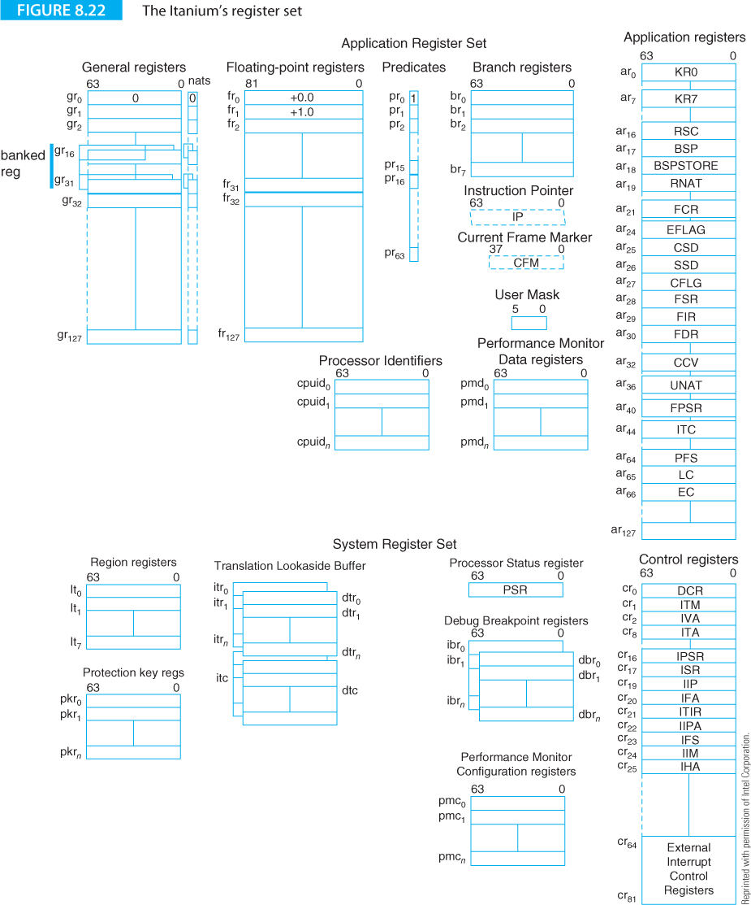
Computer Organization and Architecture: Themes and Variations, 1st Edition Clements
The IA64 has one of the most extensive user-visible register sets of any microprocessor.
General registers, Gr₀ to Gr₁₂₇, can be written as r0 to r127 and provide 128 64-bit-wide integer registers as you’d expect in almost any architecture.

Slide 66
Computer Organization and Architecture: Themes and Variations, 1st Edition Clements
IA64 Instruction Format
The IA64 instruction is 41 bits wide.
The most-significant 14 bits provide an op-code that defines the operation to be carried out.
Three 7-bit operand fields support three-operand, register-to-register instructions with a set of 128 registers.
The least-significant six bits of the op-code select one of 64 predicate registers that determines whether this instruction is to be executed or not.

Slide 67
Computer Organization and Architecture: Themes and Variations, 1st Edition Clements
IA 64 Instruction Set
We don’t cover the IA64 in detail. Here we mention some interesting instructions.
The merge or deposit instruction, dep, takes a right-justified bit field from the source and deposits it in an arbitrary location in the destination. The format of the merge instruction is
dep r1 = r2,r3,start,length
where r1 is the destination, r2 the source, start a 6-bit integer that defines the beginning of the bit field in r3 and length a 4-bit integer that defines its width. Figure 8.24 demonstrates dep r1=r2,r3,36,16 instruction. This operation can be used to pack data structures.

Slide 68
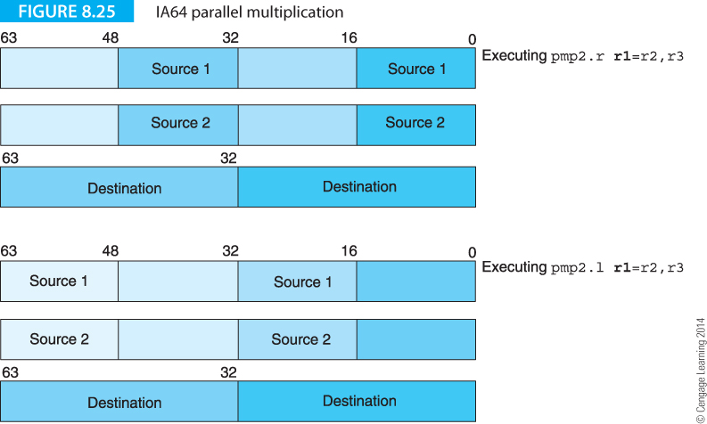
Computer Organization and Architecture: Themes and Variations, 1st Edition Clements
A 16-bit parallel multiplication instruction is provided as part of the Itanium’s multimedia support that you could use as a conventional multiplication instruction, as Figure 8.25 demonstrates.

Slide 69
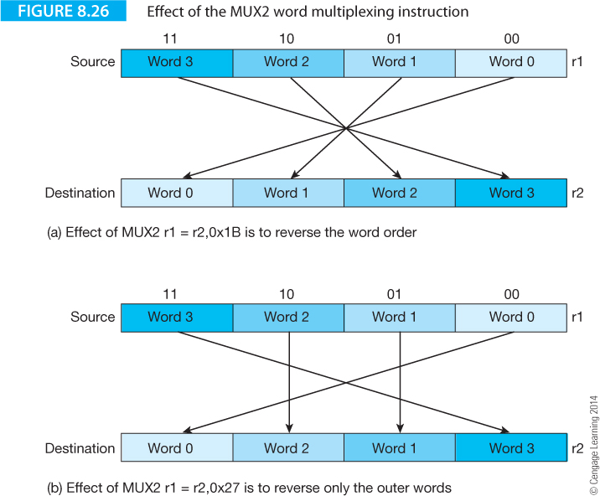
Computer Organization and Architecture: Themes and Variations, 1st Edition Clements
The IA64 provides a user programmable multiplex instruction, mux2, that allows you to specify the order of the words in a register. The format of the instruction is
mux2 r1 = r2,sequence,
where sequence is an integer specifying the order of the words.

Slide 70
Computer Organization and Architecture: Themes and Variations, 1st Edition Clements
Addressing Modes
The IA64 has a fairly simple memory accessing mechanism and supports only register indirect addressing. You can also apply an optional post-incrementing. The remarkable range of memory access operations supported by ARM processors is entirely absent in the IA64. Typical IA64 memory accesses are:
ld8 r1 = [r4] //load the 8 bytes pointed at by r4 into r1
ld8 r1 = [r4],r2 //load the 8 bytes pointed at by r4 into r1 and
//update r4 by adding r2
st8 [r2] = r5 //store the 8 bytes in r5 at the location pointed at by r2
st4 [r6] = r9,4 //store the 4 bytes in r9 at the location pointed at by r6
// and post increment r6 by 4
Note that the load and store operations have a size completer that indicates the number of byte loaded or stored (1, 2, 4, or 8); for example ld4, st8.

Slide 71
Computer Organization and Architecture: Themes and Variations, 1st Edition Clements
Instructions, Bundles and Breaks
We now return to two concepts that we have already briefly introduced, the bundle and the break that are related to the IA64’s VLIW-like architecture.
IA64 bundles are 128 bits long and the processor reads a 16-byte instruction bundle containing three op-codes.
The three op-codes occupy positions slot 1, slot 2, and slot 3. It’s not always possible to fill each slot with a useful instruction and sometimes you have to pad slots with no operations, NOPs.
Because an IA64 instruction is 41 bits long, a bundle has 128 – 3 x 41 = 5 bits left over to provide extra information about the current bundle.

Slide 72
Computer Organization and Architecture: Themes and Variations, 1st Edition Clements
The five low-order bits of an instruction bundle are called its template, because they indicate they indicate the type of the current bundle and map the instruction slots onto the IA64’s processing units.
The IA64 is a highly specific form of a superscalar processor with independent execution units that can deal with individual instructions which permits their parallel execution. Table 8.1 demonstrates the relationship between instruction type and execution unit. The IA64’s execution units are the I-unit that performs integer operations, the F-unit that performs floating-point operations, the M-unit that performs memory related operations (load and store), and the B-unit that performs branch operations.
Instruction Type | Description | Execution Unit Type
A | Integer ALU | I-unit or M-unit
I | Non-ALU integer | I-unit
M | Memory | M-unit
F | Floating-point | F-unit
B | Branch | B-unit
L+X | Extended | I-unit/B-unit

Slide 73
Computer Organization and Architecture: Themes and Variations, 1st Edition Clements
Table 8.2 relates the encoding of each bundle’s template to the instruction type in terms of processing units. Some of the instructions are in blue to indicate the presence of a stop or break in the instruction sequence that defines the limit of a region of parallel execution.
Template | Encoding | Type | Slot 0 | Slot 1 | Slot 2
0 | 00000 | MII | M | I | I
1 | 00001 | MII | M | I | I
2 | 00010 | MI_I | M | I | I
3 | 00011 | MI_I | M | I | I
4 | 00100 | MLX | M | L | X
5 | 00101 | MLX | M | L | X
6 | 00110
7 | 00111
8 | 01000 | MII | M | M | I
9 | 01001 | MII | M | M | I
10 | 01010 | M_MI | M | M | I
11 | 01011 | M_MI | M | M | I
12 | 01100 | MFF | M | F | I
13 | 01101 | MFF | M | F | I
14 | 01110 | MMF | M | M | F
15 | 01111 | MMF | M | M | F
16 | 10000 | MIB | M | I | B
17 | 10001 | MIB | M | I | B
18 | 10010 | MBB | M | B | B
19 | 10011 | MBB | M | B | B
20 | 10100
21 | 10101
22 | 10110 | BBB | B | B | B
23 | 10111 | BBB | B | B | B
24 | 11000 | MMB | M | M | B
25 | 11001 | MMB | M | M | B
26 | 11010
27 | 11011
28 | 11100 | MFB | M | F | B
29 | 11101 | MFB | M | F | B
30 | 11110
31 | 11111

Slide 74
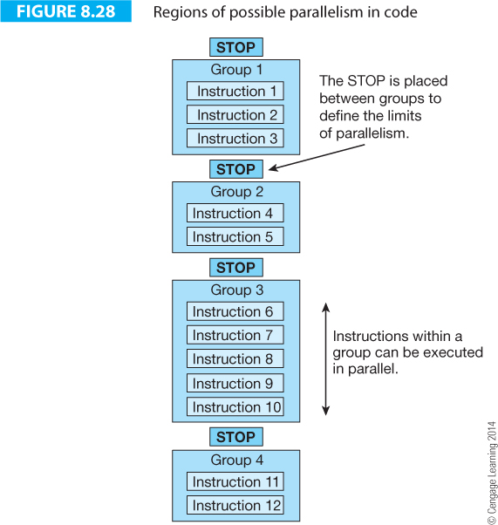
Computer Organization and Architecture: Themes and Variations, 1st Edition Clements
A STOP is placed between groups to limit the extent of the parallelism; for example, the instructions in group 1 must be executed before the instructions in group 2. The sequence in which instructions are executed is determined by the compiler, which places the STOPs in the instruction stream. A STOP ensures that a RAW (read after write0 hazard does not take place by ensuring the competition of instructions up to the STOP.

Slide 75
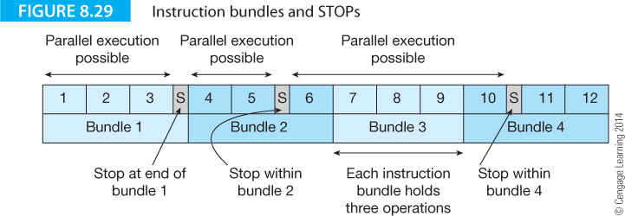
Computer Organization and Architecture: Themes and Variations, 1st Edition Clements

Slide 76
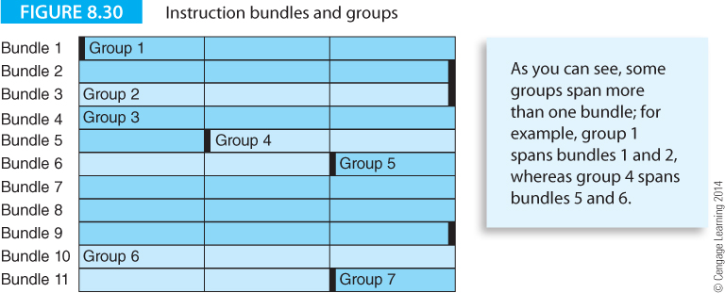
Computer Organization and Architecture: Themes and Variations, 1st Edition Clements

Slide 77
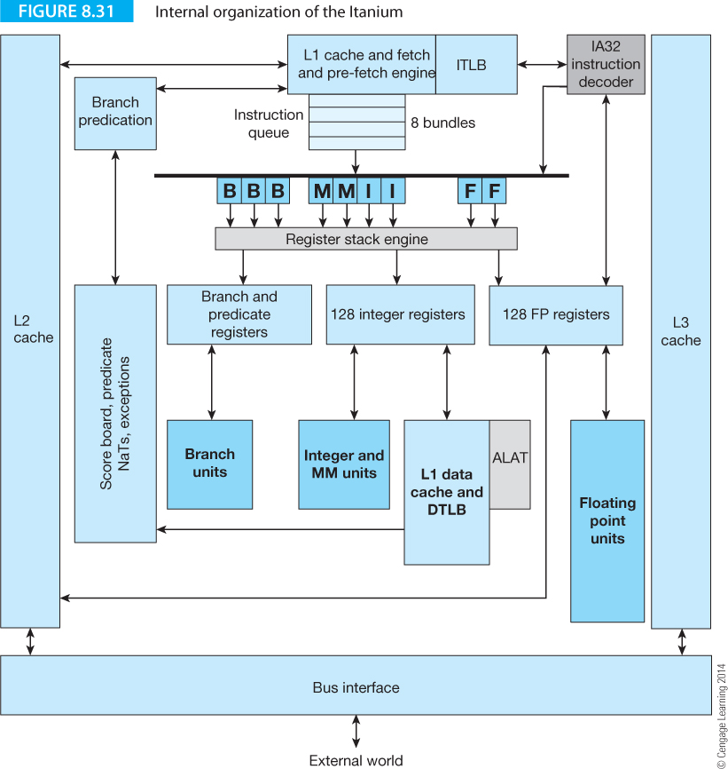
Computer Organization and Architecture: Themes and Variations, 1st Edition Clements

Slide 78
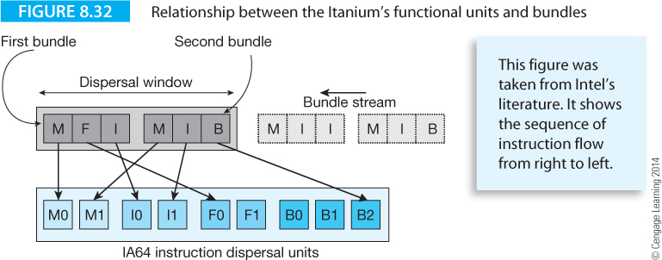
Computer Organization and Architecture: Themes and Variations, 1st Edition Clements
Figure 8.32 demonstrates the execution of a code stream consisting of four three-instruction bundles. Remember that the compiler is responsible for ordering the instruction stream into bundles that can be executed by the Itanium.
The Itanium can hold two bundles in its dispersal window and issue up to six instructions per cycle using the two M slots, the two I slots, the two F slots, and the three B slots.

Slide 79
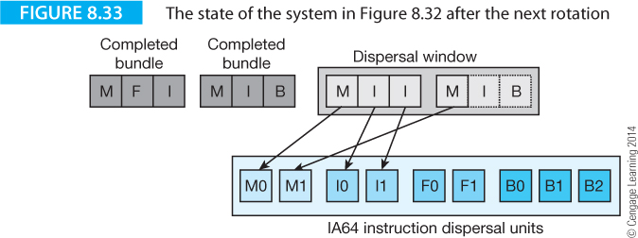
Computer Organization and Architecture: Themes and Variations, 1st Edition Clements
In Figure 8.33 the two bundles that were in the dispersal window have been executed and the following two bundles brought into the dispersal window. Intel uses the term rotation to indicate that a new bundle is brought into the dispersal unit. In this case a double rotation has occurred.

Slide 80
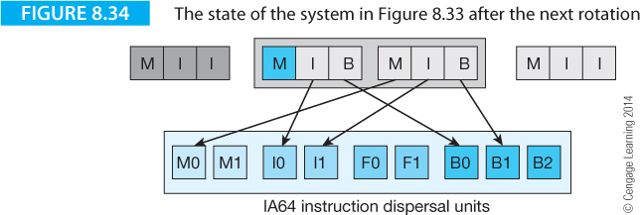
Computer Organization and Architecture: Themes and Variations, 1st Edition Clements
In Figure 8.33 all three instructions in the first bundle, MII, in the dispersal window have been issued to the execution unit. Unfortunately, not all the instructions in the second bundle can be issued because of the lack of integer units.
In the next rotation, Figure 8.34, only one new bundle enters the instruction dispersal unit. Instruction issue continues with the I and B instructions of the first bundle and the M, I and B instructions of the second bundle.

Slide 81
Computer Organization and Architecture: Themes and Variations, 1st Edition Clements
The IA64 code is branchless, more compact than the CISC code, and the two predicated instructions can be carried out in parallel in the same cycle. A simple example of the effective uses of predication is provided by Geva and Morris. Consider the code fragment
if (x == y) {
z++;
p += q;
} else {
r++;
}
This sequence can be translated into the following IA64 code.
To keep things simple we will use register names consisting of “r” plus the variable name; for example rx is the register that holds x.

Slide 82
Computer Organization and Architecture: Themes and Variations, 1st Edition Clements
This sequence can be translated into the following IA64 code.
{
cmp.ne p1 = rx,ry // Perform the initial compare x == y
(p1) br else // If true then do the else part
}
{.label then
add rz = rz, 1 // z++
add rp = rp, rq // p += q
br exit // jump over else part
}
{
.label else
add rr = rr, 1 // r++
}

Slide 83
Computer Organization and Architecture: Themes and Variations, 1st Edition Clements
This is conventional but inefficient code because it is divided into blocks separated by conditional or unconditional branches. If the conditional test is mispredicted, the cost is high. Why? Because the IA64 is a parallel processor and a lost cycle potentially throws away up to three instructions.
The following version of the algorithm makes better use of prediction by setting two predicate registers when the test is performed and then executing three simultaneous operations; two of which are predicated on true and one on false. The second block performs all the computation in a single cycle.
{
cmp.ne p1,p2 = rx,ry // Perform the initial compare x == y
} { //This block executes in one cycle
(p1) add rp = rz, 1 // z++
(p1) add rp = rp, rq // p += q
(p2) add rr = rr, 1 // r++
}

Slide 84
Computer Organization and Architecture: Themes and Variations, 1st Edition Clements
{
cmp.ne p1,p2 = rx,ry // Perform the initial compare x == y
} { //This block executes in one cycle
(p1) add rp = rz, 1 // z++
(p1) add rp = rp, rq // p += q
(p2) add rr = rr, 1 // r++
}
The cmp.ne instruction compares the contents of rx and ry and sets predicate registers p1, p2 to 1,0 if the outcome of the test is true and 0,1 if the outcome is false. The next three instructions are executed if the associated predicate register is true.

Slide 85
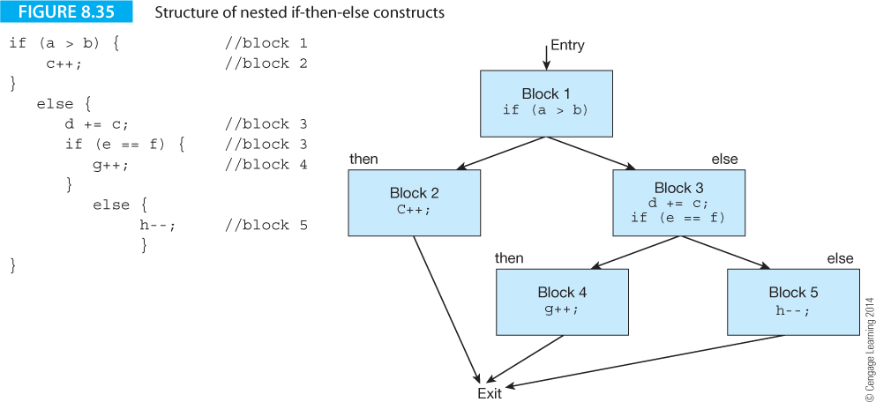
Computer Organization and Architecture: Themes and Variations, 1st Edition Clements
Let’s look at another example of predication from Geva and Morris.
Figure 8.35 illustrates an if-then-else construct with a second nested if-then-else in the first else path.
Predication provides efficient code because compare instructions themselves may be predicated (as we found with ARM code).

Slide 86
Computer Organization and Architecture: Themes and Variations, 1st Edition Clements
The construct of Figure 8.35 can be written as.
{
cmp.gt p1, p2 = ra, rb // block 1
} {
(p1) add rc = rc,1 // block 2
(p2) add rd = rd, rc // block 3
(p2) cmp.eq.unc p3, p4 = re, rf // block 3
} {
(p3) add rg = rg, 1 // block 4
(p4) add rh = rh, -1 // block 5

Slide 87
Computer Organization and Architecture: Themes and Variations, 1st Edition Clements
Note how the two components of block 3 are both predicated by p2. The second component of block 3 is the test
(p2) cmp.eq.unc p3, p4 = re, rf
which carries out the test if (e == f) and sets predicate registers p3 and p4.
However, the additional completer, unc (unconditional) overrides the normal behavior of the comparison.
If the qualifying predicate is true, the cmp.eq.unc behaves normally and p3, p4 are set to 0,1 or 1,0 depending whether the outcome of the test was false or true, respectively.
Now, if the qualifying predicate in p2 is false and the .unc completer is specified, the two predicates are forced to 0. In this case, if (p2) is zero then both (p3) and (p4) are forced to zero.

Slide 88
Computer Organization and Architecture: Themes and Variations, 1st Edition Clements
The .unc completer can be used to prevent both paths of a nested conditional being executed; in this case blocks 4 and 5.
Predicated execution can be used as an effective way of implementing multiway braches as the following example demonstrates.
{ .mii
cmp.eq p1,p2 = r1,r2
cmp.ne p3,p4 = 4, r5
cmp.lt p5,p6 = r8,r9
}
{.bbb
(p1) br.cond label1
(p3) br.cond label2
(p5) br.cond label3
}
In this example three comparisons are performed in the first cycle and a branch made in the second cycle if any of the conditions is satisfied.

Slide 89
Computer Organization and Architecture: Themes and Variations, 1st Edition Clements
Control Speculation
The load instruction is a nuisance because it has a latency that can be fairly short if the data is in the highest level of the cache, or very long if the data is well down the memory hierarchy.
To add insult to injury, many of the loads take place at the beginning of a block of code where they do most damage, because data has to be read before it can be used.
Figure 8.36(a) illustrates the situation in which a branch is made to a block of code that includes a load instruction. At best, the load is fetched from high-level cache. At worst, the data is not even in main store and a page-fault occurs, forcing the operating system to get the data from disk.
You could move the load instruction up to an earlier point in the program, called hoisting the instruction. Hoisting sometimes allows you to avoid some of the load latency, but you pay a horrendous price if you read a location, generate a page fault and then find that you never really wanted the data because you don’t branch to the block that uses it.

Slide 90
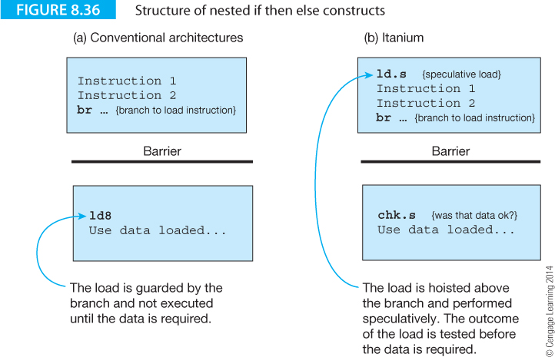
Computer Organization and Architecture: Themes and Variations, 1st Edition Clements

Slide 91
Computer Organization and Architecture: Themes and Variations, 1st Edition Clements
Figure 8.36(b) shows how the Itanium provides control speculation by using the ld.s instruction to perform a load before the data is needed and then a chk.s instruction immediately before the data is required.
Consider the effect of an ld2.s r1 = [r9] instruction. This does what you would expect; it loads register r1 with the contents of the memory location pointed at by r9.
The notion of speculation means that the load is not yet needed, it is opportunistic The load may or may not be carried out at a later point in the program.
Because the load is speculative, exceptions that the load might have generated are deferred. There’s no point in dealing with exceptions for an instruction whose execution may not be necessary.
When an exception is deferred, the destination register’s not-a-thing bit, NaT, is set.

Slide 92
Computer Organization and Architecture: Themes and Variations, 1st Edition Clements
At a later point in the program, the load that was speculatively executed may be needed if we branch to the region of code where it is used. We can’t just go ahead and use the value that was loaded speculatively. We have to check whether the earlier speculative load was successful. We use the load instruction with a check, chk.s, to determine whether the load was successful. One parameter required by the check instruction is the address of the code that deals with a failed speculative load. Consider the following fragment of code.
ld8.s r7 = [r8] //read the pointer speculatively
//more code
cmp.eq p1 = r9,r0 //is r9 == 0?
(p1) br.xyz //this is the branch that guards the load
.
.
xyz: chk.s r7,Error //verify the load
xyz1: .
.
Error: ld8 r7 = [r8] //try again
br xyz1 //and return

Slide 93
Computer Organization and Architecture: Themes and Variations, 1st Edition Clements
We read a pointer if the contents of register r9 are zero.
However, ld8.s r7 = [r8] reads the pointer speculatively before it is needed. If the load is successful, all is well. If the load is unsuccessful due to a page fault, the register’s NaT bit is set and processing continues.
If the branch is taken, the speculative load is checked by chk.s r7,Error.
If the load was successful, the value in r7 is used. If the load was not successful and the NaT bit in r7 is set, a branch is made to Error where the code needed to perform the recovery lies.
What has this arrangement gained? If a page fault does not occur, the load latency required by the load is hidden because the load took place before it was needed.
The only downside is that we’ve added extra instructions for the error checking and we’ve tied up register r7 from the time of the speculative load.

Slide 94
Computer Organization and Architecture: Themes and Variations, 1st Edition Clements
The Advanced Load
An advanced load also performs a load operation before the operand is needed. This operation is indicated by appending the completer .a to a load instruction. Consider the following fragment of code.
ld4.a r7 = [r8] //read the 32-bit word here
add r4 = r4,1 ;; //increment r4
st4 [r9] = r4 //store the new r4
ld4.c r7 = [r8] ;; //test the load – was it ok?
add r6 = r7,8 //use the data we’ve read
In this example, the ld4.a r7 = [r8] instruction performs the initial advanced load. Later, the ld4.c r7 = [r8] instruction checks or verifies whether the advanced load was successful.
If the advanced load was successful, the operation continues. If the operation failed, the load must now be repeated.

Slide 95
Computer Organization and Architecture: Themes and Variations, 1st Edition Clements
How does an advanced load differ from a speculative load? The advanced load deals with the problem of disambiguation. Disambiguation means removing the ambiguity surrounding two addresses. Let’s look at an example from Geva and Morris where a simple test is performed on an element pointed at by *a and a flag updated if the test is true.
unsigned char flag; //a global variable declared in the program
.
.
int test (int *a, *b) //a function with two pointers as parameters
{
if (*a) //test the value pointed at by *a
flag += 1 //if it’s not zero then increment global variable flag
return (*b – 1); //decrement the variable pointed at by *b
}
In this fragment of code, three values have to be loaded from memory: flag, *a, and *b. Geva and Morris assume that these variables are cached and a load requires six cycles. Figure 8.37 illustrates how the code might be structured conventionally (i.e., without hoisting). The code takes 16 cycles.

Slide 96
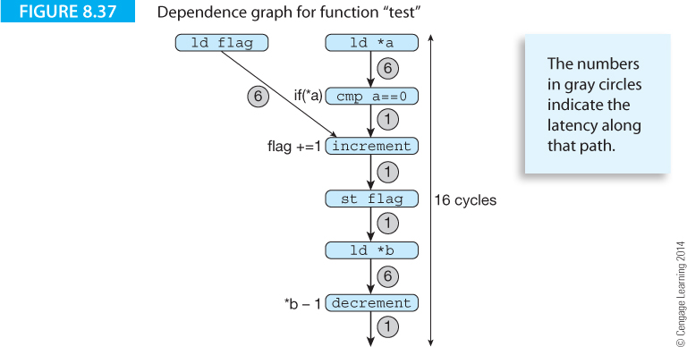
Computer Organization and Architecture: Themes and Variations, 1st Edition Clements

Slide 97
Computer Organization and Architecture: Themes and Variations, 1st Edition Clements
We can load flag and *a at the same time. However, we can’t load *b until after the flag has been stored. Why? Because *b and flag might be the same location. Clearly, if we were to load *b before storing the updated flag, the semantics of the program would be altered.
Now, you and I know that *b and flag are not the same variables and no problem exists. We can perform these two memory accesses in parallel without changing the program’s semantics.
Unfortunately, the Itanium has not taken a course in C; nor has it read the source code and decided that flag is an unsigned char and *b a pointer to an integer variable.
Since the Itanium accesses memory via pointer-based addressing, it cannot know whether or not two pointers are pointing at the same variable. Consequently, it has to be cautious.

Slide 98
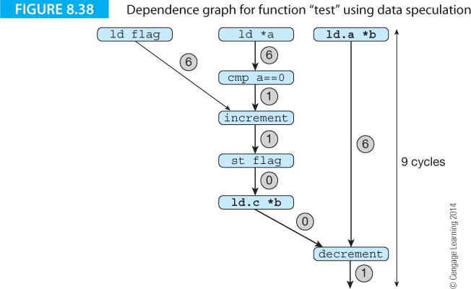
Computer Organization and Architecture: Themes and Variations, 1st Edition Clements

